Slide 1
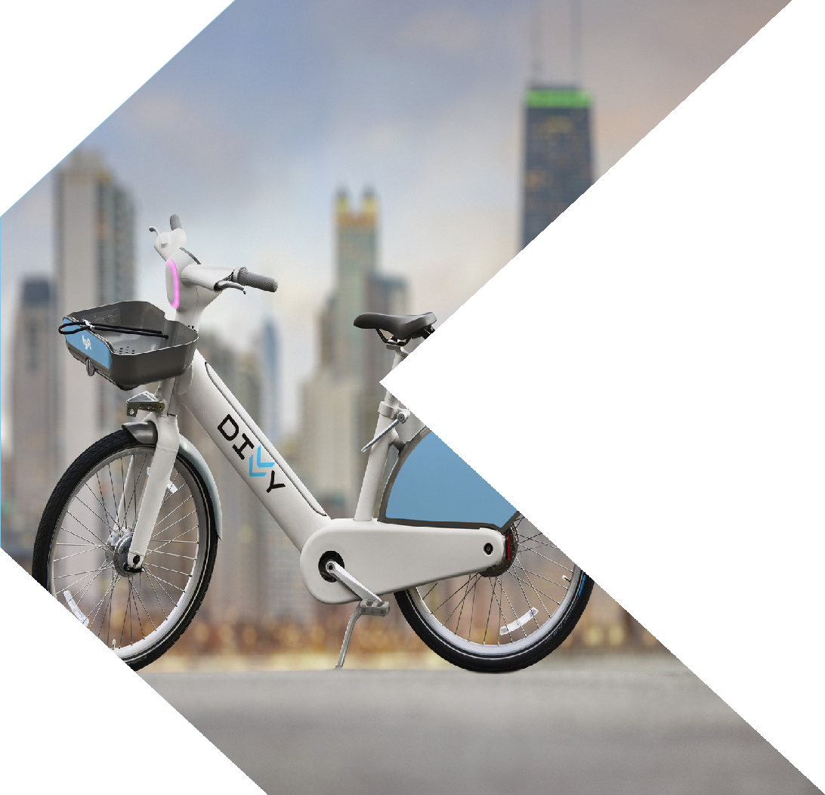

UNITED NATIONS OF BIKES
Business Srategies For Divvy
RISE AND RIDE WITH US

Slide 2
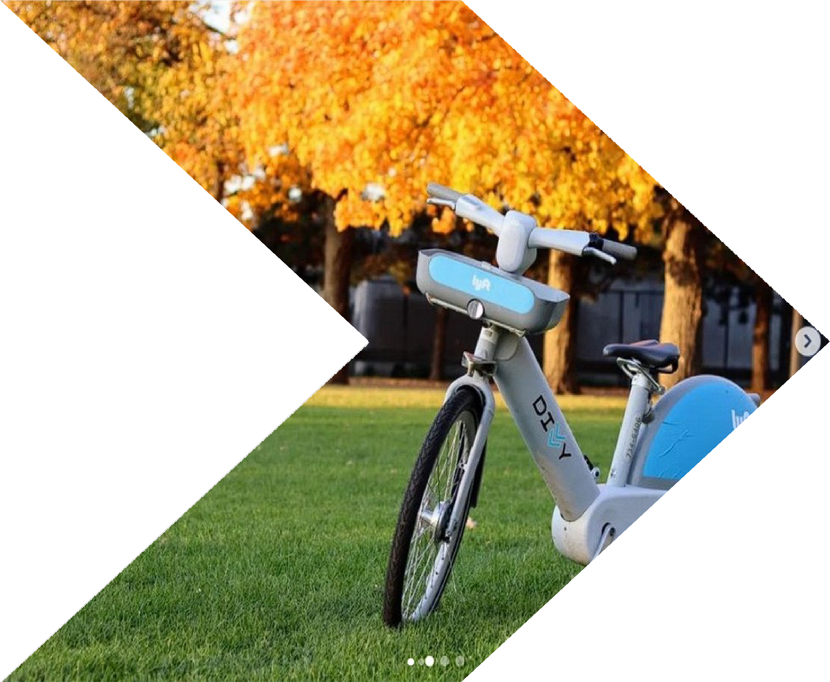

PROMPT
WHO ARE WE?
We are a group of professional consultants with years of experiences in providing services for bike-sharing industry
WHAT IS OUR
WGeOaAreLg?oing to analyze the business of our client, Divvy - the primary bike-
sharing system in Chicago, and provide strategic plans for our client to grow in this fast-changing industry
WHAT DATA DID WE
WUeSaEre?using the Divvy ridership data from 2014 to the end of 2017

Slide 3
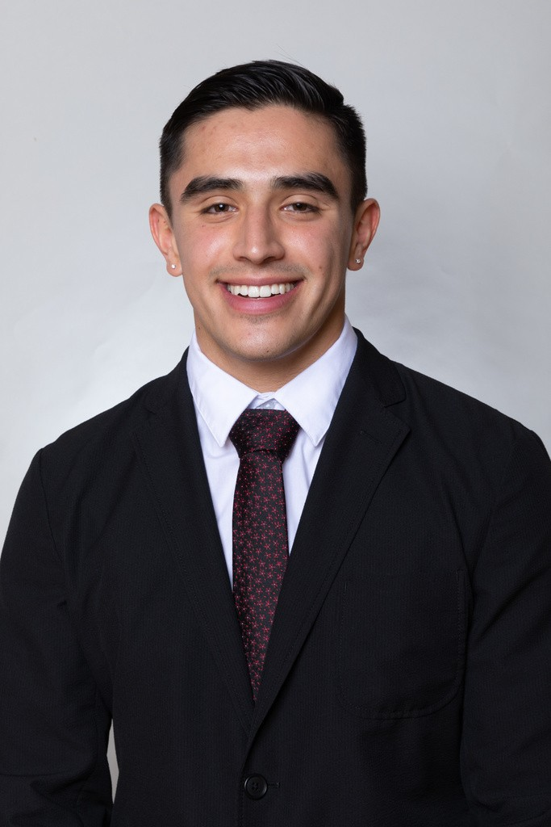
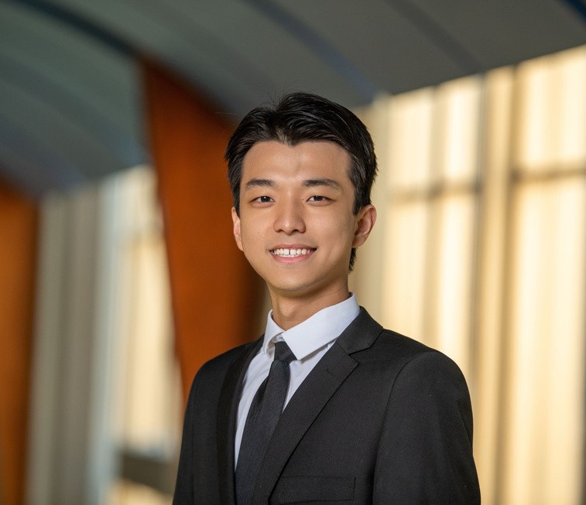
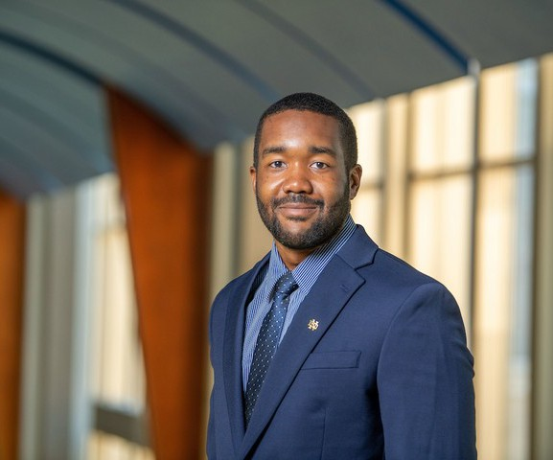
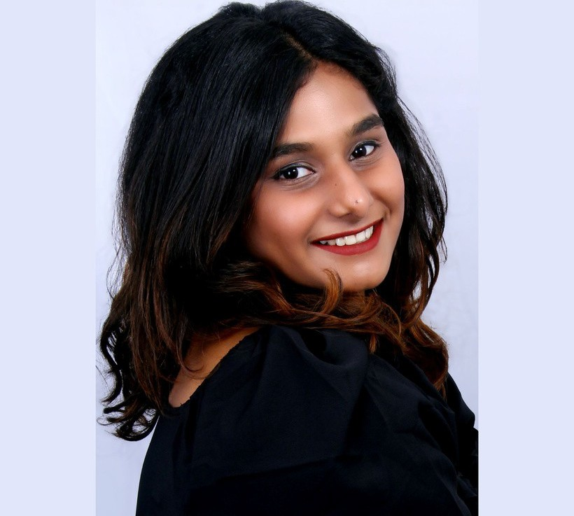
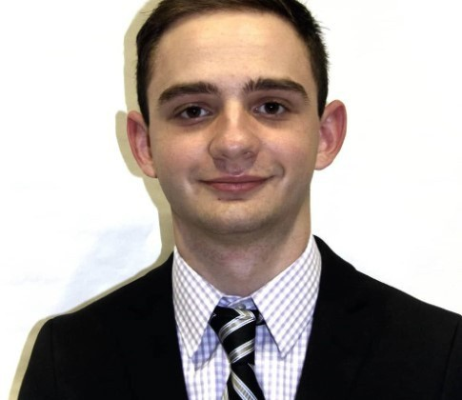
MEET THE PROFESSIONALS
Carlo Lopez
Daniel Huang
Derrell Coleman II
Vibha
Garrett

Slide 4
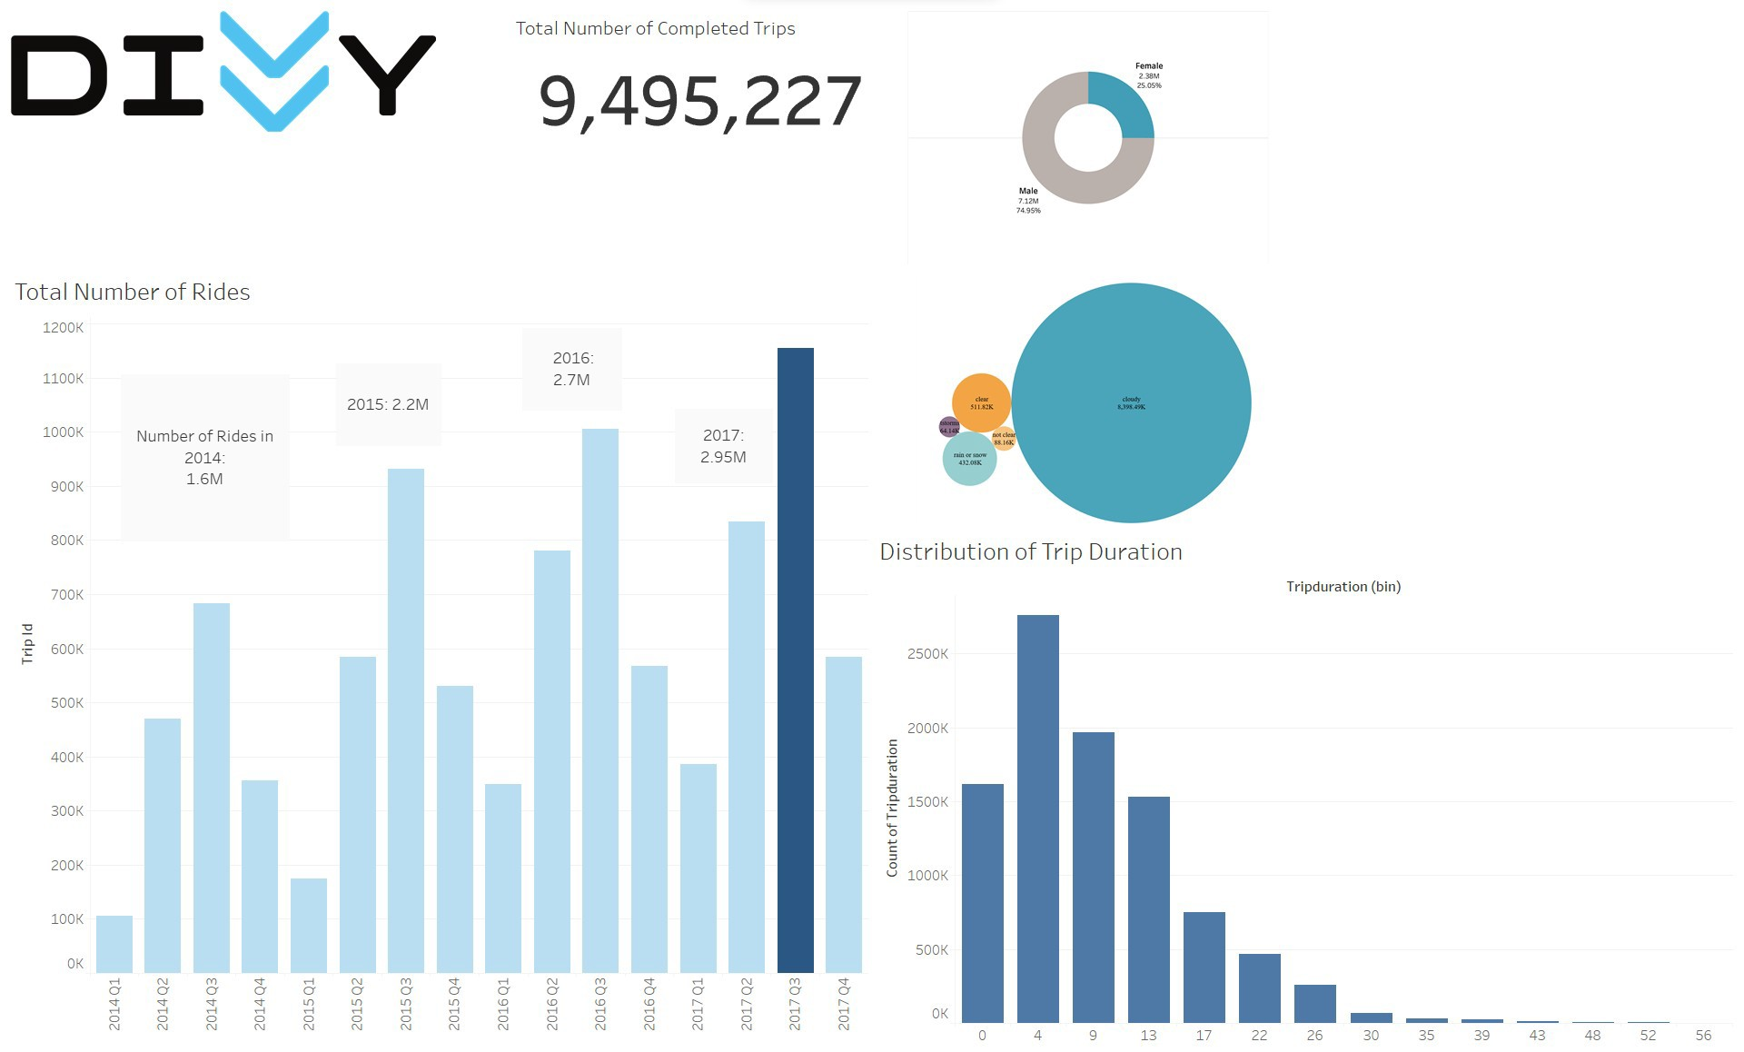

User Gender Distribution
Data Source: Divvy Bike Ridership Stats from 2014 Q1 to 2017 Q4
Distribution of Trip
in Different Weather

Slide 5


EXPANSION S
Most Popular Stations - Why?
Least Popular Stations - Why?
Recommendation

Slide 6
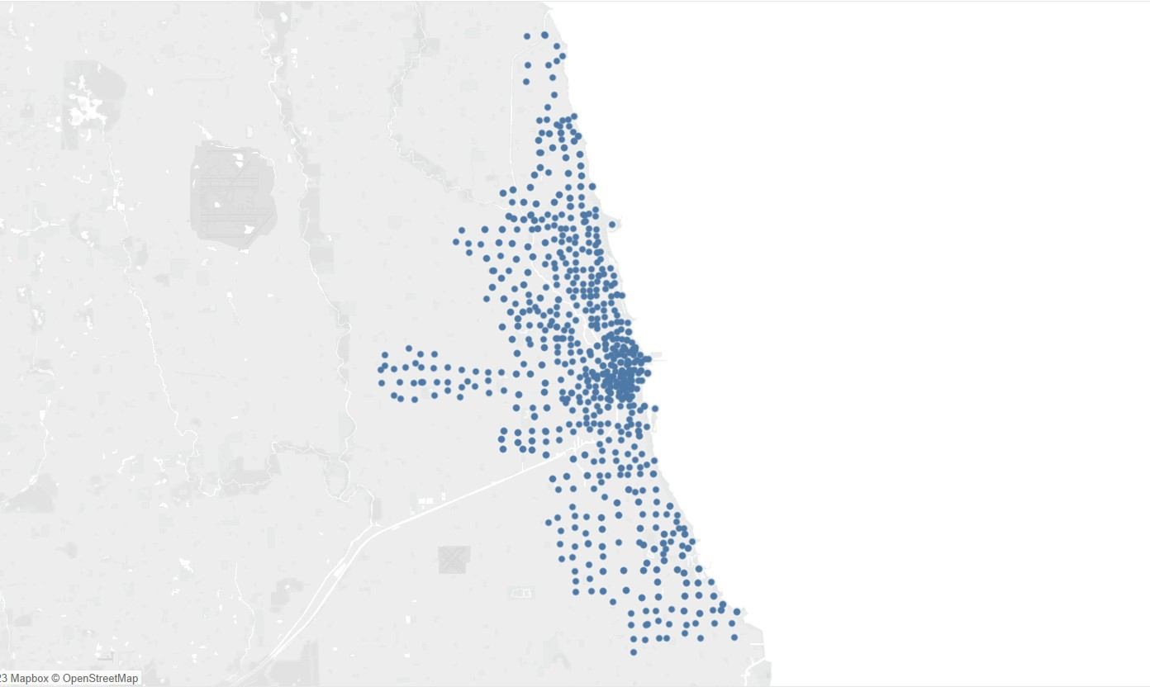
TOTAL STATION
592

Slide 7
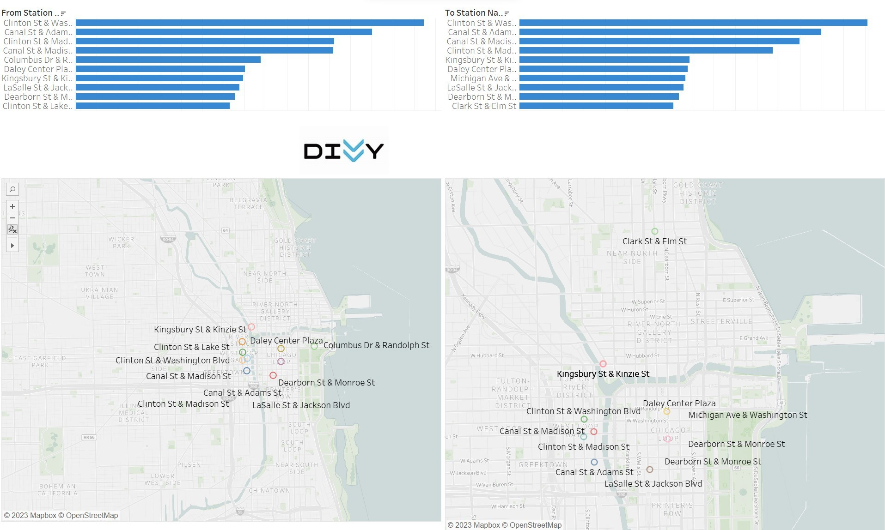
Arrival
Departure
Most Popular Stations

Slide 8

Arrival
Departure
Most Popular Stations

Slide 9
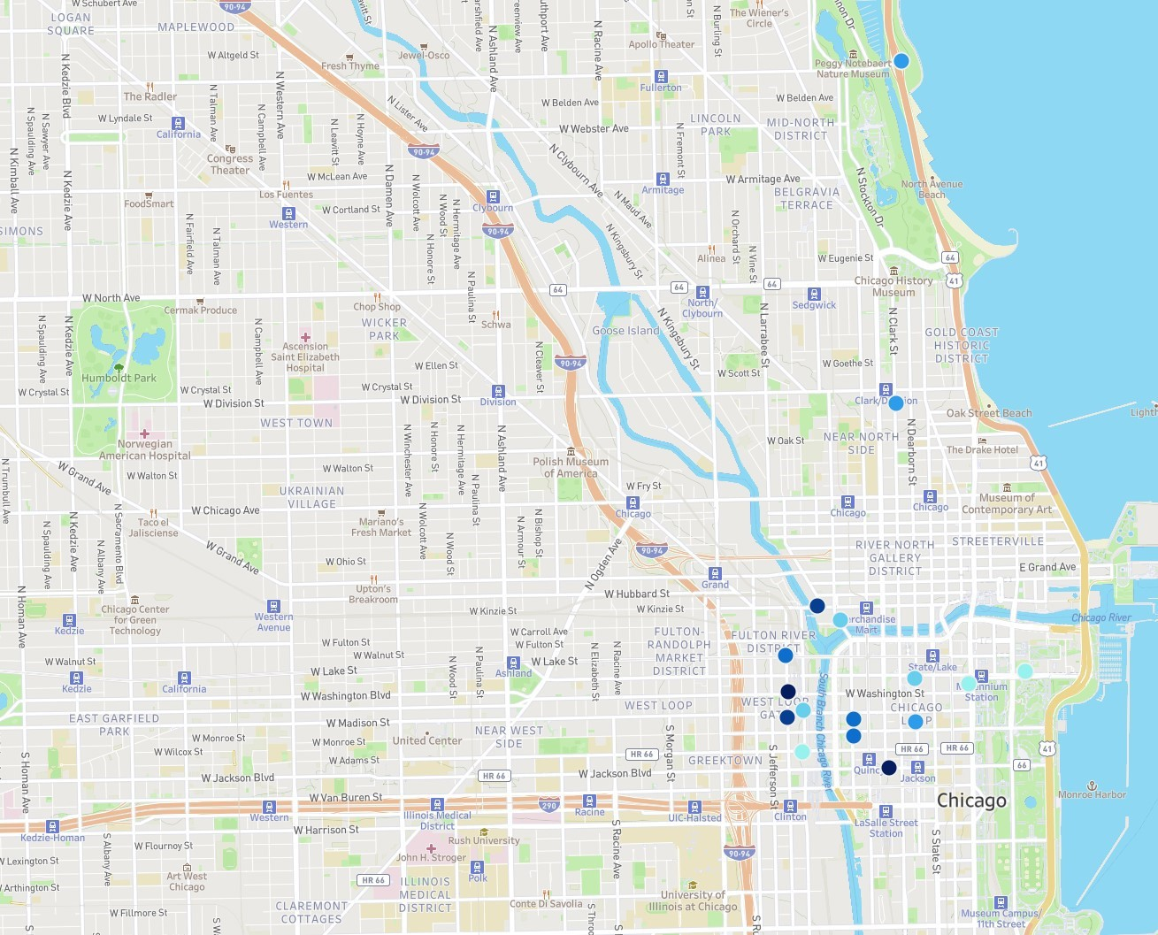



Slide 10





Slide 11
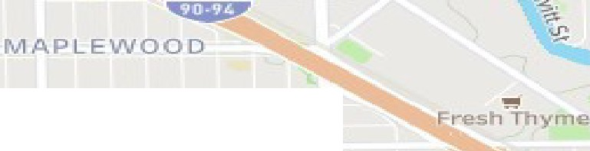
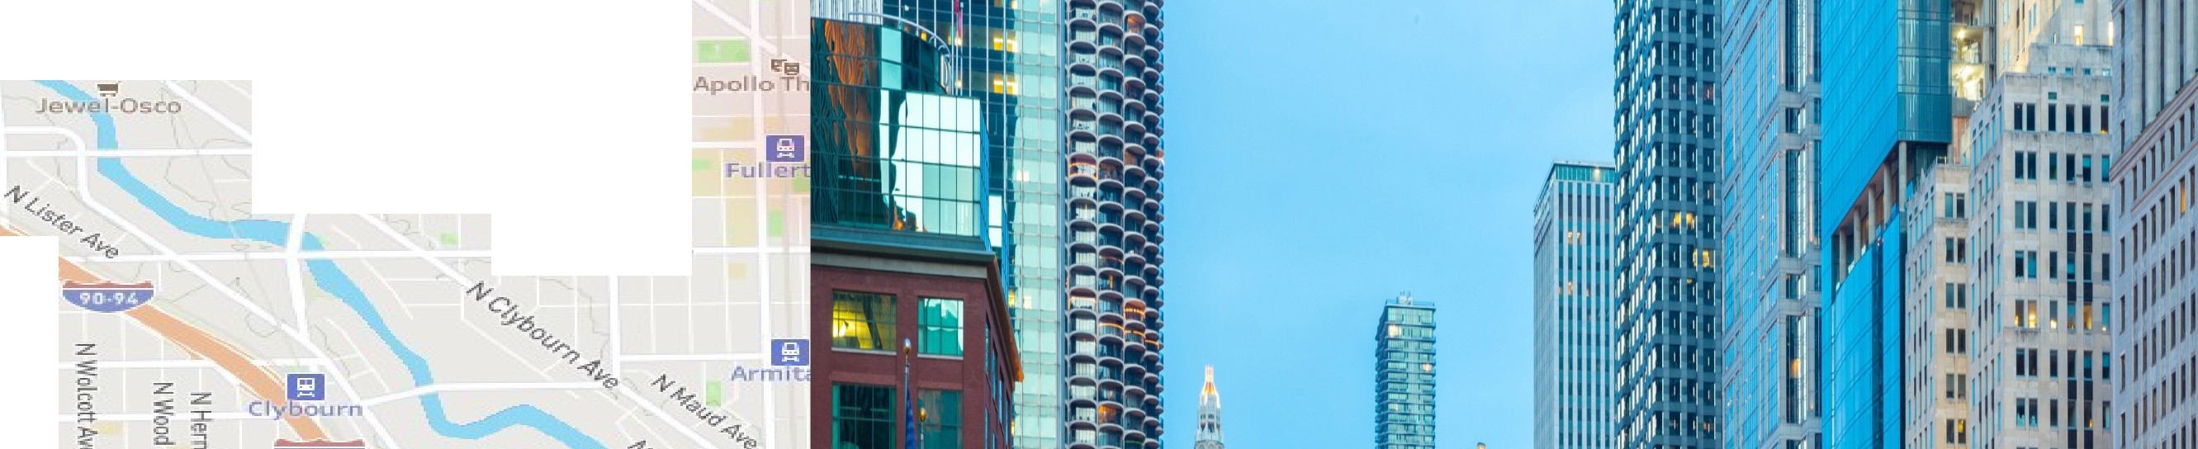

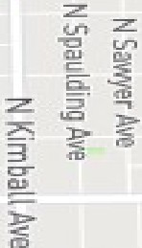


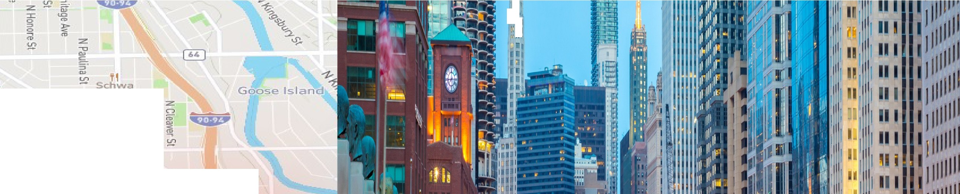


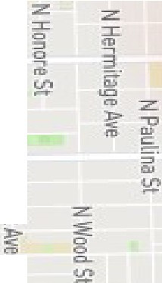

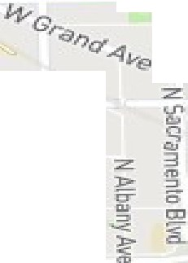
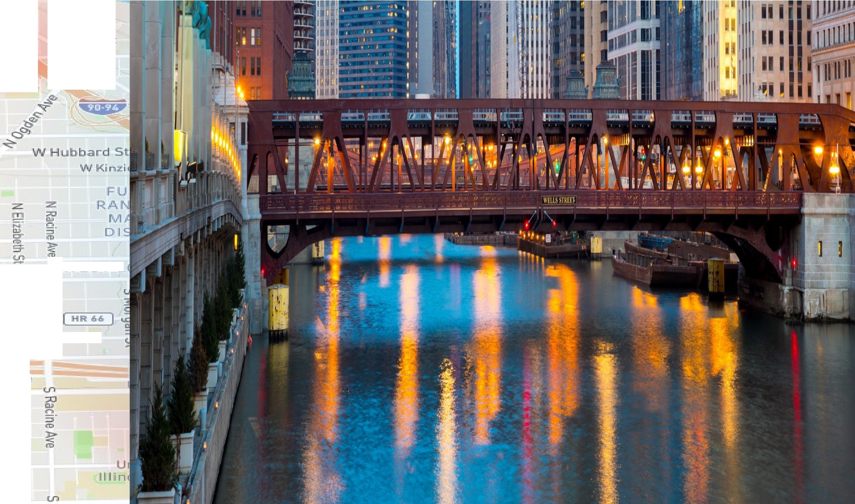












<'I:!
s-
LOGAN SQUARE
n,
=<D
z
::,
s.
--c:,
·z.
G:
-
a..
0
'::I.
:::0
)>
"c,.'_
W Altg Ldl St
II:,
=:r i'a
ro
::JI
ft>
JU
z
,fD
:,
CD-
T1
:Z.
ro
The Radler-
z:
VJ Bolden AoJe
W Lynda Li'.!- St
IEI ^{3"'}
Calilornia l
a^{n}>
-.:::,
er
--,
5
:z:.
z
--
3
.----
::c
W Webster Ave
10
l'D
'"'
a,
lf"li!I Congr-ess Theater
Ir,
-
:::,
:;;;;;
t
Los Fuentes
:=I:.
z:
cu,
,1
W tv'lcLea.n Ave
0
'!!!I
FoodSmart
m
³,m,
r
:z.
W Cortland St :=:i
i,IMONS
-n
Western
DJ
II
;'.'I
Ill 11
11,
11 •
=l'llo
=j"
ci:
:!"
rt>
W North Ave
'!!!I
ChoJ hop
WICKER
PARK
z
C.
'^{N}6.
.
Cermak Proch..1 e
:z
<."")
lfil
+
Ascensron
[ Saint. 1::llz;aibeth
Hospital
W E:Llen St
n,,
W Crystal St
Humboldt Park
W Crystal SL
W Divis.ion St
WEST TO\t\r'N
WCryst□l St
W DiviisLon St
GI
Oiv1s1on
Norw⁺egian
a
Polish Mu-;eum
ofAmenc-a
z
₋-,II
C:
American Hospftal
WWattonSt
WWal'tonSt
3
UKRAINIAN VlLLAGE
W Fry 5t
c,-
s.
rti-
"
W Chic.ago A've
z
El
:z:
:z
:,:::
CD CL
Taco el
Marr:no's
:z
Chicago
U'l
Jaliscien!..e
Fr-esh Mar-ket '8
=D.J
'!:::!.
:::;;:
3
....
c::
n;,
CJ
a:
C
·
m
WOhi,c;,St
T1
,,..^{n}...
l>
:z:
iii
a
Upton•
BrEakroom
:c
Chicago Center for Green Tedmology
W Kin ie- St
W CarroLLA..-e­
W FultonSt
1:1 W Lake St
sli'Tand
0
3
CJ
::::;i
WFulton S't
WWalr,ul'St
WL.ake.St
«>
WWalnutSt
Kla·!,e
EAST GAR!=IELD
PARK
GI
California
W Washington Blvd
WEST L
W Monroe St
W Madi.son St
W Mon eS't
WAdamsSt
NEAR WEST SIDE
VIJ Wilcax St
W Jacks,on Blvd
[ HJU6 ]
W Jackson BLvcl
m
Kedzie-Homan
Iii
W Harri.son St
+ Rush ^{et}vorsity
Uni
Racine
W Aourl"toySt
ILLINOIS a MEDICAL DISTRt CT
V Lex;ing ton, St
Art We t
Chle.ago
John H. St:roger
I ArthingLonSt
[ MR 66 ]
,1
Conw Di Savolfa i:.n
W Flllmo.-e S'I:
CLAREMONT
COTTAGES
--4
;;;r
U')
cl
,0

Slide 12
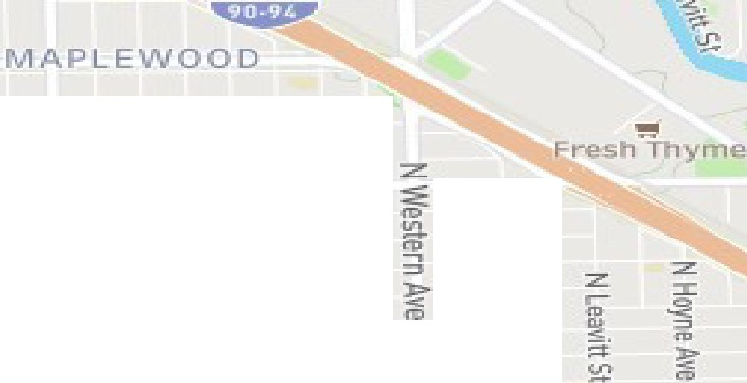
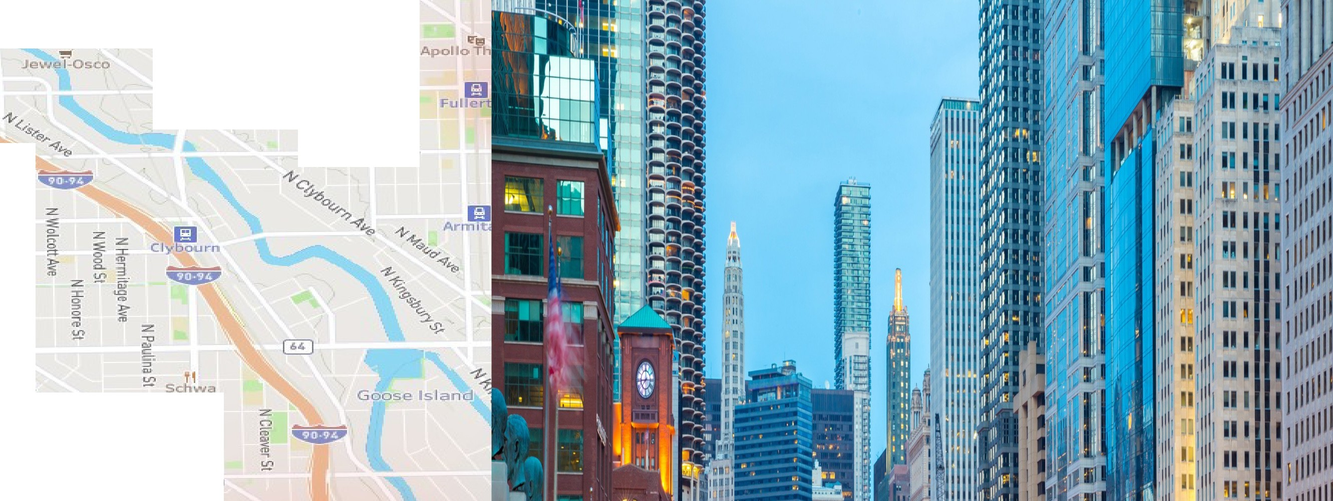
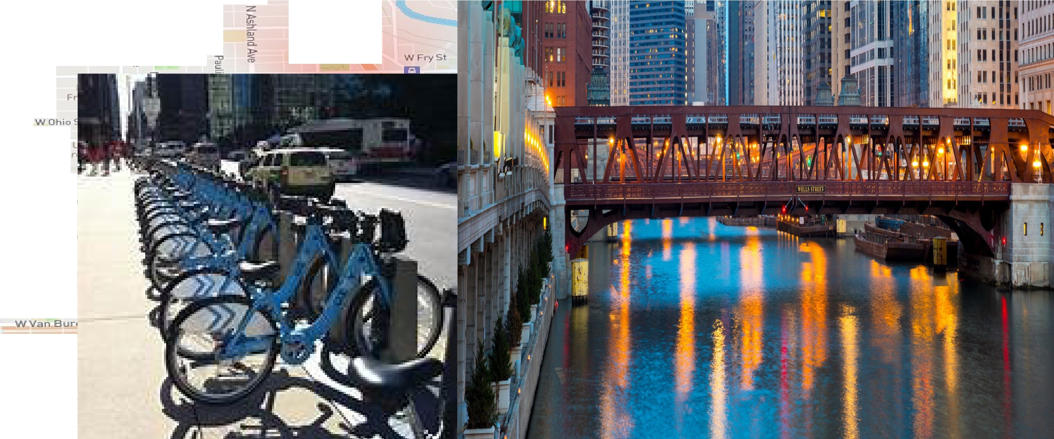



,;,:l
s-
LOGAN SQUARE
-n,
=<D
z
::,
s.
--c:,
·z.
G:
-
a..
0
"::I.
:::0
)>
",c-',._
W Altg Ldl St
II:,
-::::::r
i'a
ro
::JI
ft>
JU
Q.
:-
c::,
:,
CD-
T1
:z:.
ro
The Radler-
i
z:
VJ Bolden AoJe
W Lynda Li'.!- St
IEI
Cal rnia l
n
a>
-.:::,
W Webster Ave
--
3
er
!!;
lf"li!I Congr-ess Theater ,i,
z:
cu,
³,m,
ii
,1
W tv'lcLea.n Ave
0
'!!!I
FoodSmart
Los Fuentes
:z.
m
W Cortland St
i,IMONS
-n
Western
DJ
=l'llo
=j"
ci:
:!"
rt>
W North Ave
'!!!I
ChoJ hop
z
C.
'^{N}6.
.
Cermak Proch..1 e
:z
<."")
lfil
WICKER
PARK
+
Ascensron
[ Saint. 1::llz;aibeth
Hospital
W E:Llen St
n,,
W Crystal St
Humboldt Park
W Crystal SL
WDivis.ion St
WEST TO\t\r'N
W Cryst□l St
W DiviisLon St
GI
=
Oiv1s1on
z:
Norw⁺egian
-;;:
=CJ
0
.^{IA}.....
z
::::i:
American Hospftal
WWattonSt
:::.,
:a
Polish Mu-;eum
ofAmenc-a
g..
ii.I"
^{<D} ::z.
rt>
WWal'tonSt
m.
I₋i,,"
....
l.Cl
"
UKRAINIAN
VlLLAGE
:z:
:z
:,:::
CD CL
Taco el
W Chic.ago A've
U'l
Jaliscien!..e
=D.J
'!:::!.
c::
n;,
a:
m
:z:
:a
:c
Chicago Center for Green Tedmology
B
0
3
CJ
::::;i
WFulton
'IN
WL.ake.St
«>
WWalnutSt
Kla·!,e
EAST GAR!=IELD PARK
GI
California
WWashingto
WMadi
W Mon e::
WAdan
VIJ Wilcax St
W Monroe St
W Jacks,on Blvd
m
W Harri.son St
Kedzie-Homan
W Aourl"toySt
V Lex;ing ton, St
Art We t
Chle.ago
(
I ArthingLonSt
CLAREMONT COTTAGES
U')
W Flllmo.-e S'I:

Slide 13
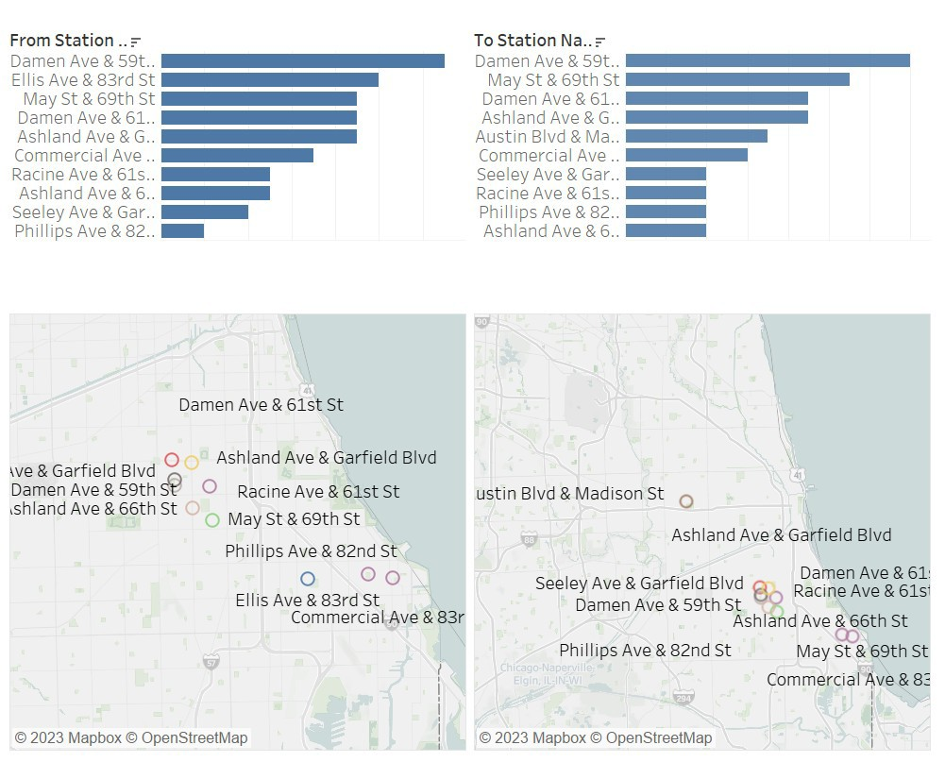
Departure Arrival
Least Popular Stations

Slide 14
Departure Arrival
Least Popular Stations

Slide 15
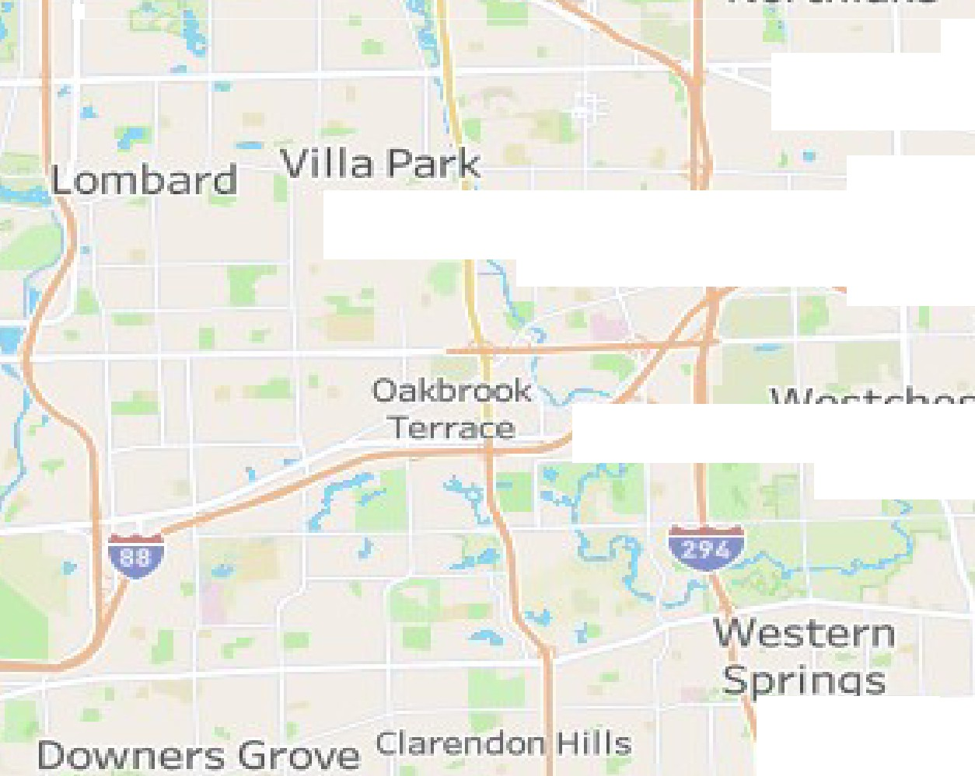
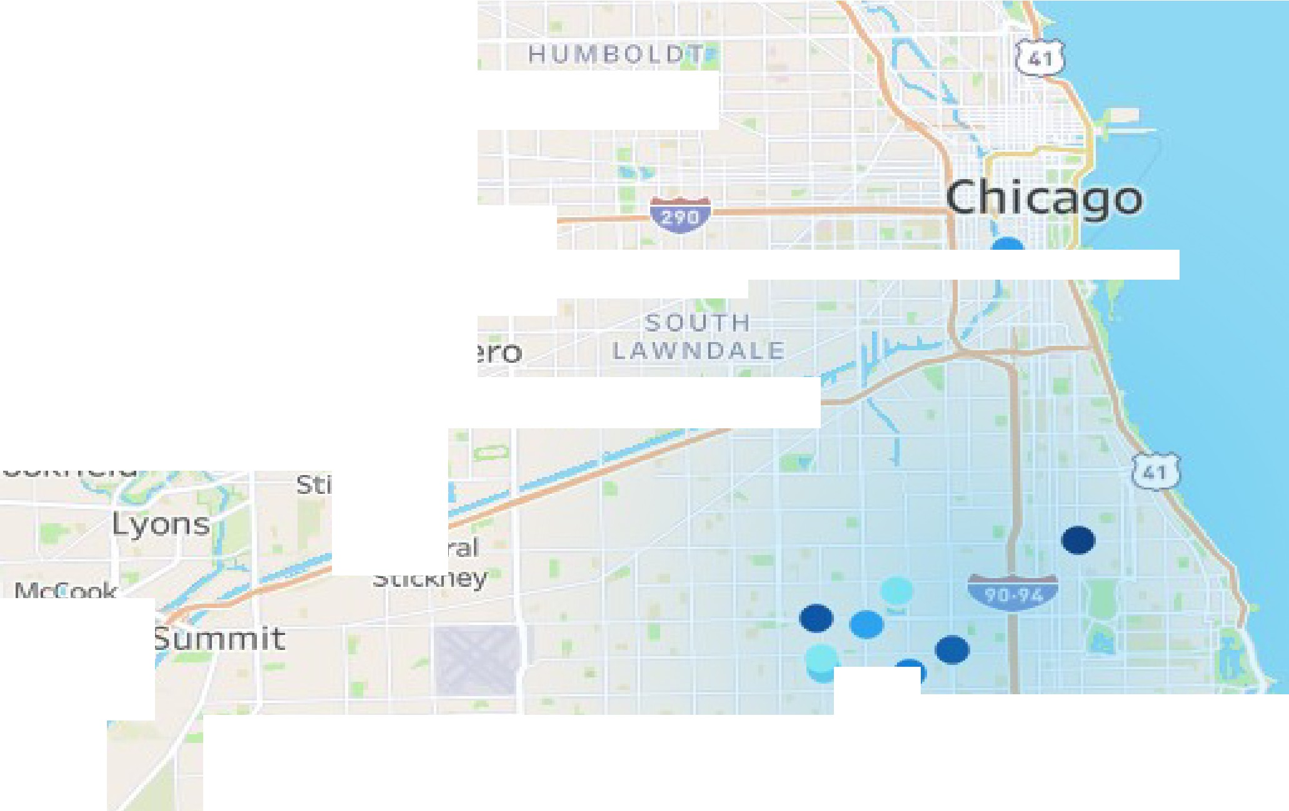
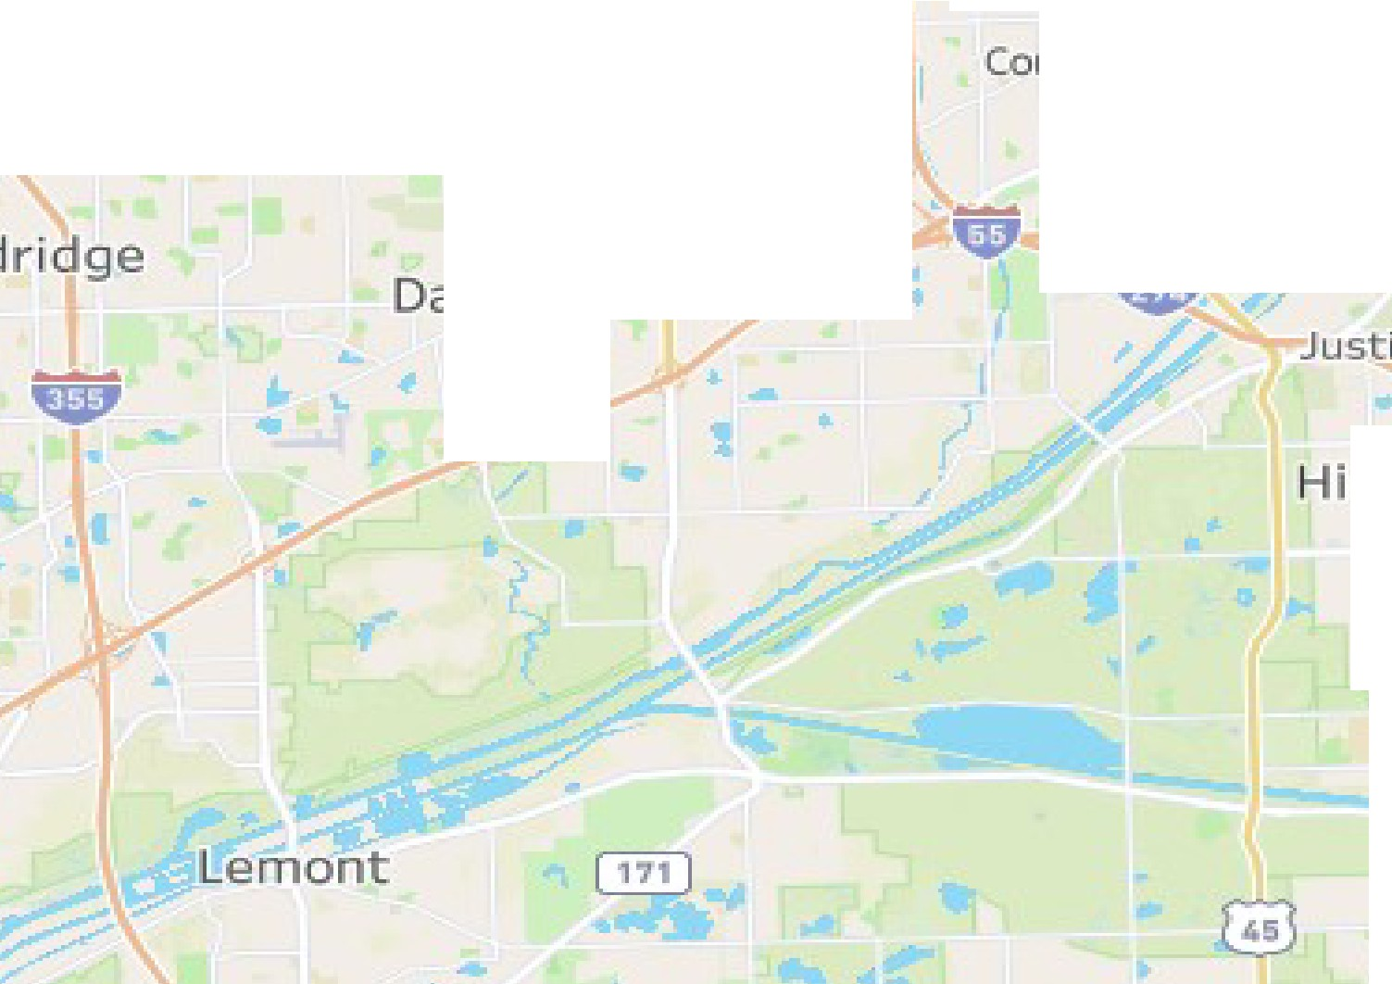

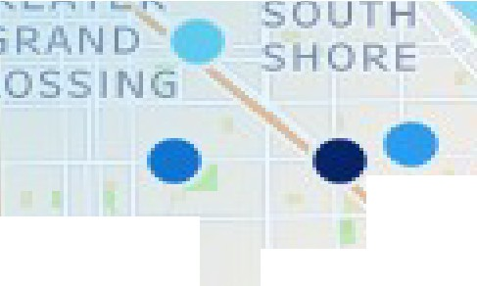

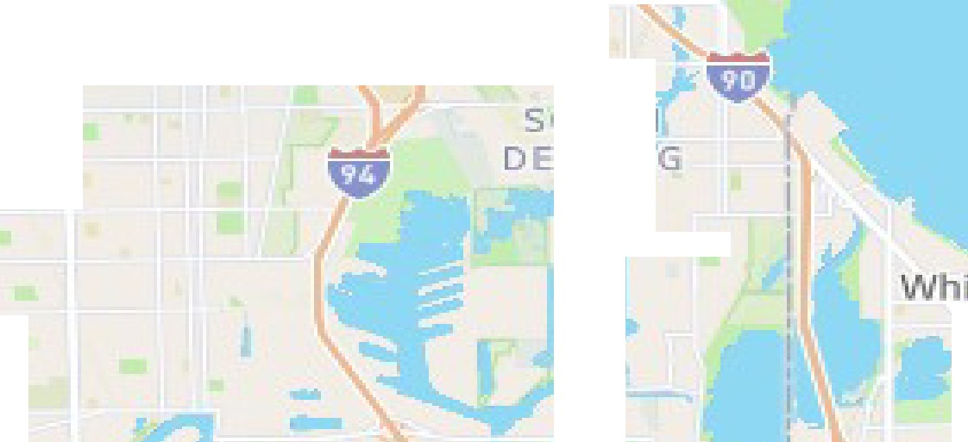
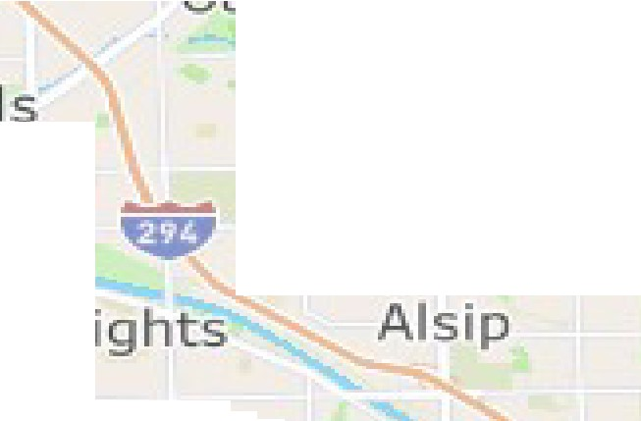

..
-
Northlake
Elmwood Park
Melrose Par!<
H
D
Villa Park
-
_
..,
>
Bellwood Maywood
Oak Park
..
•
0
.,
ii ••
'f@P
Broadvie'll\l'
Westchester
Berwyn
Cicero
SOUTH
LA\l\t
DALE
West¹ern Springs
Stickney
Mc€ook
••₋•
AUBURN
GI F-S HAr1,,1
Downers Grove claren don Hii Is
Countryside
Bed o₋rd Park
Burbank
\t\tl1101,•, brook
odgkins
Darien
-- -
:Justice
SOUT
H
Hickory HiIls
Hometo•Hn
G
Evergreen Park
.......
Oak lawn
'11
sou
Palos Hills
-
DEERING
er-r-io11ette
Par
W
Palos Heights

Slide 16
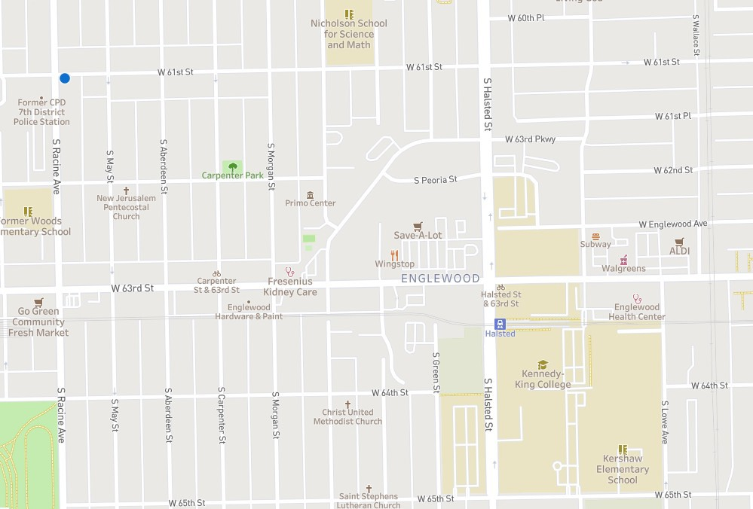
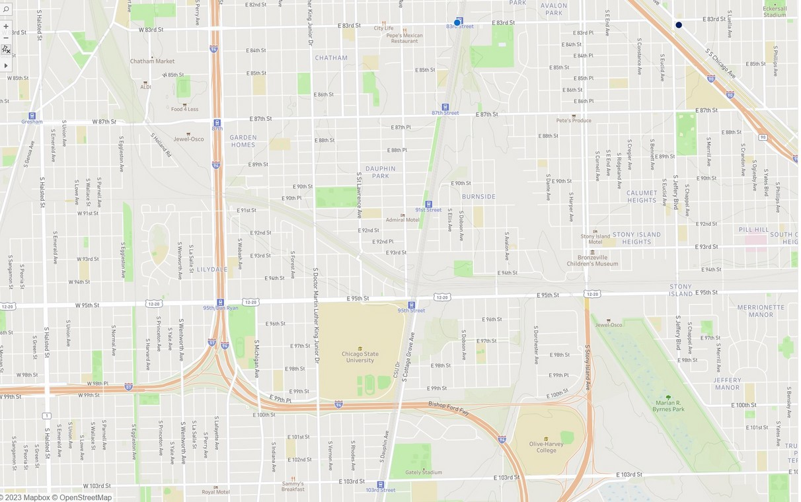





Projected Stations
Existing Station
Projected Station

Slide 17
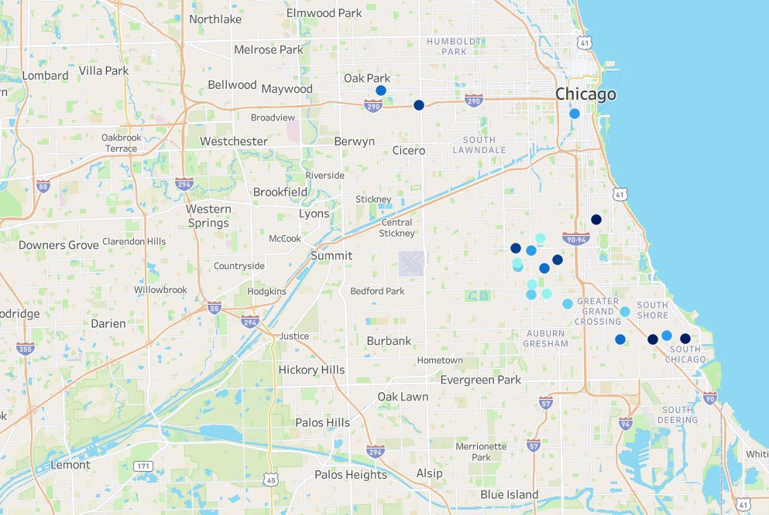

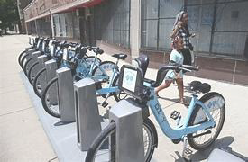
Accessibility

Slide 18
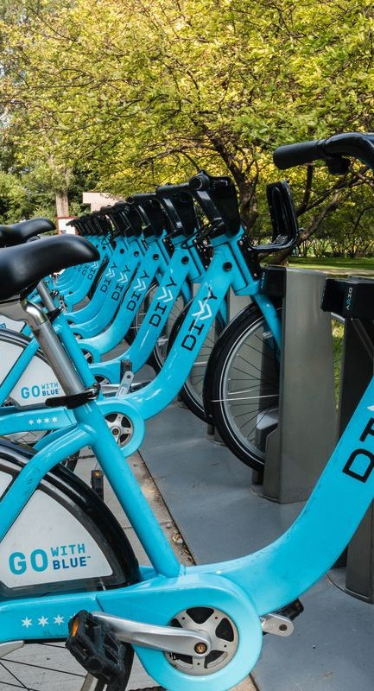
RECOMMENDATIO NS
Add more bike stands to increase accessibility
Adding connectivity in the South and Downtown
Safety? New features

Slide 19
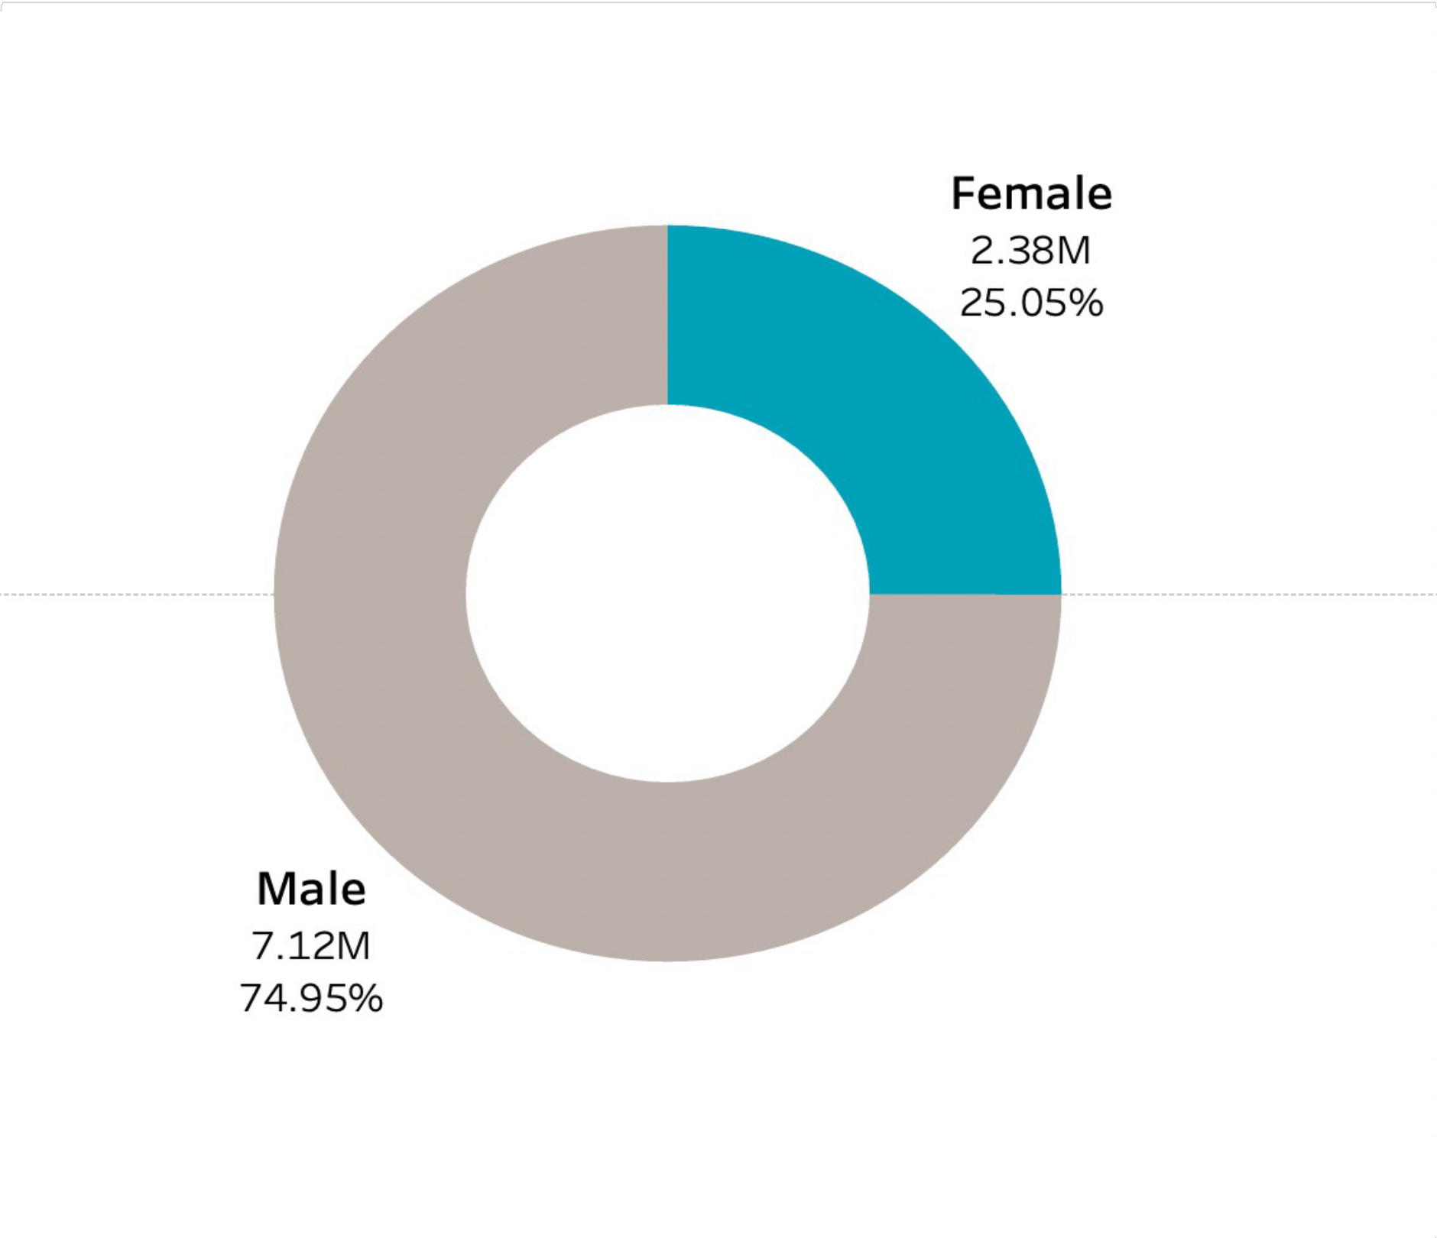
SUBSCRIBER ANALYSIS
FEMALE
U• SOnEly 2R5%Sof total subscribers
DIVVY is missing out on business
Why is this happening?

Slide 20
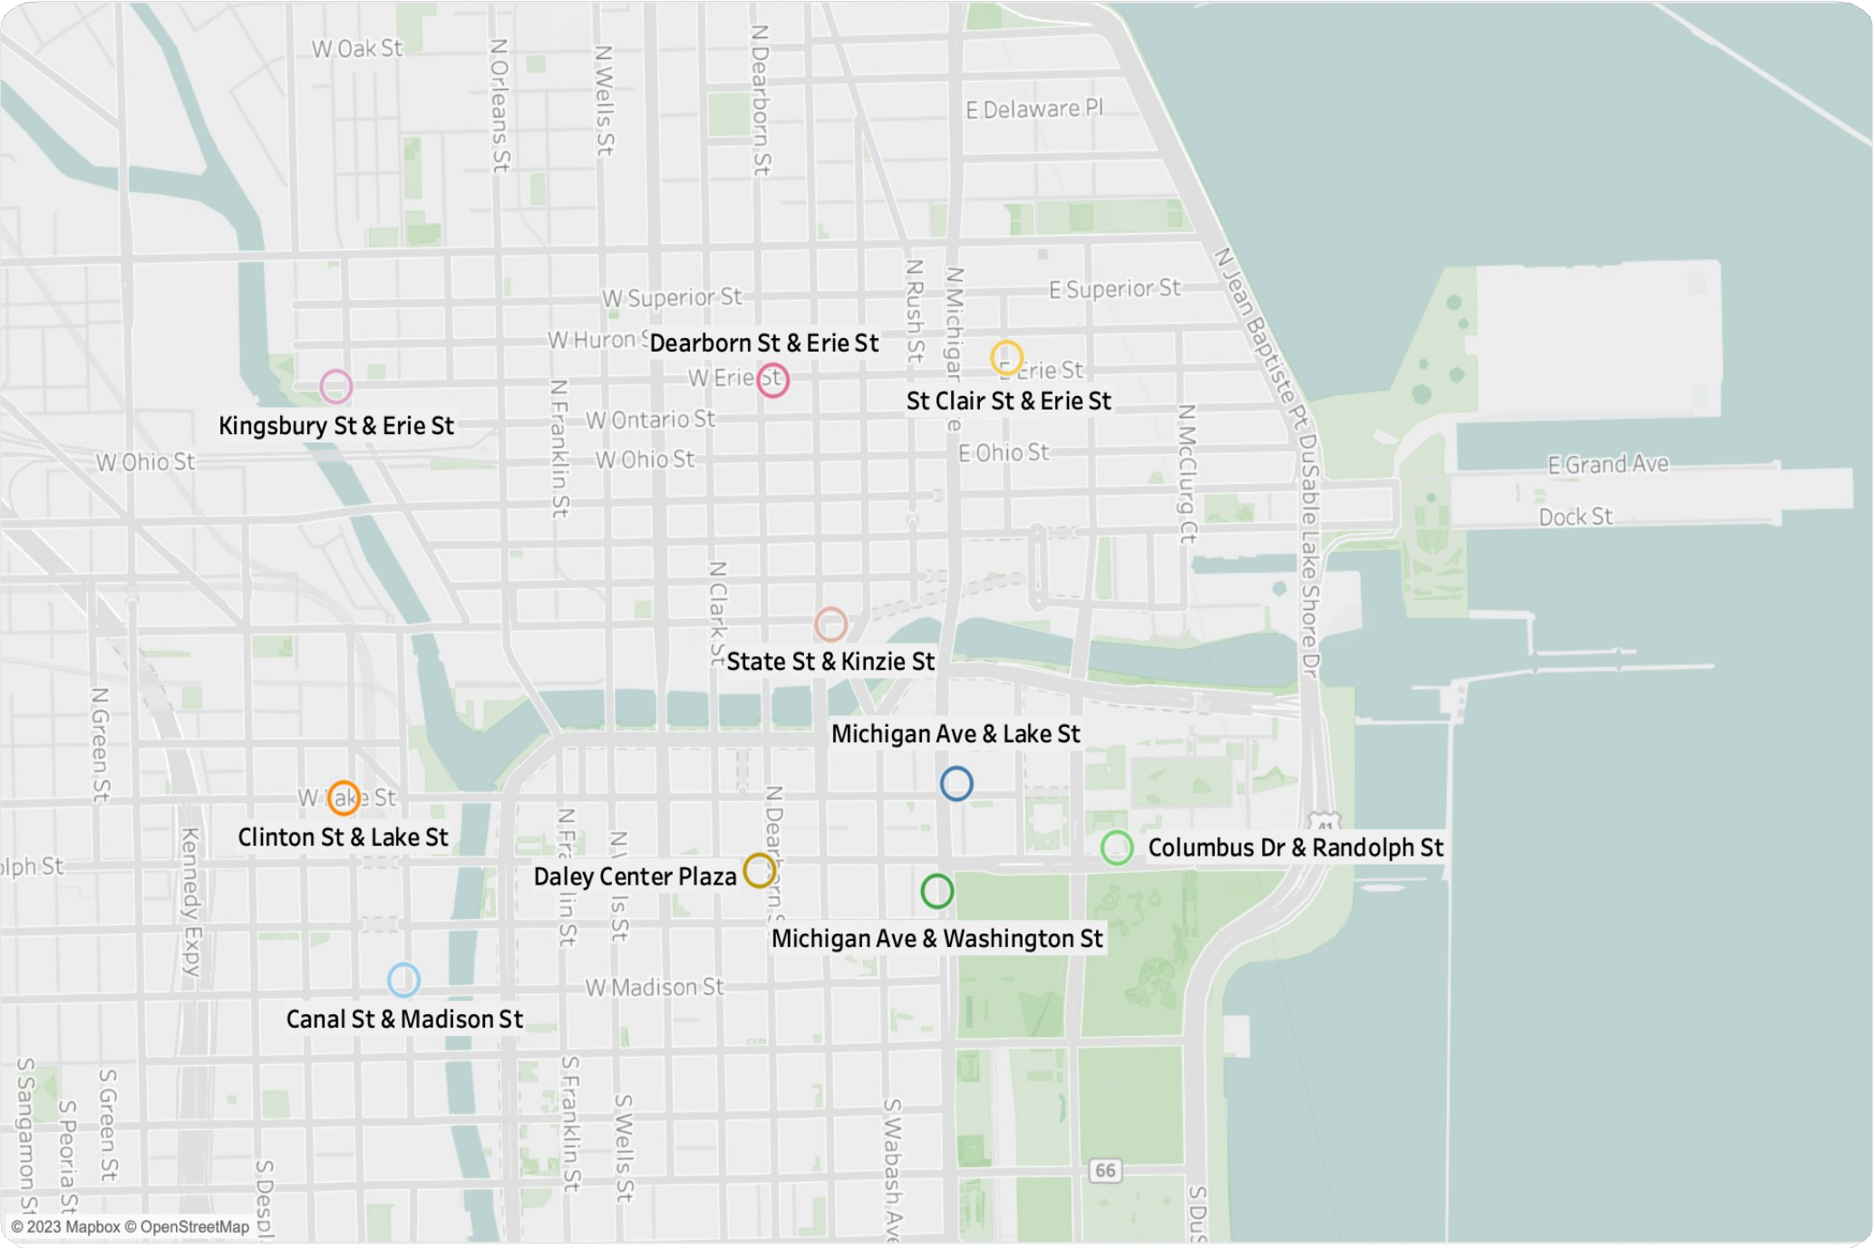
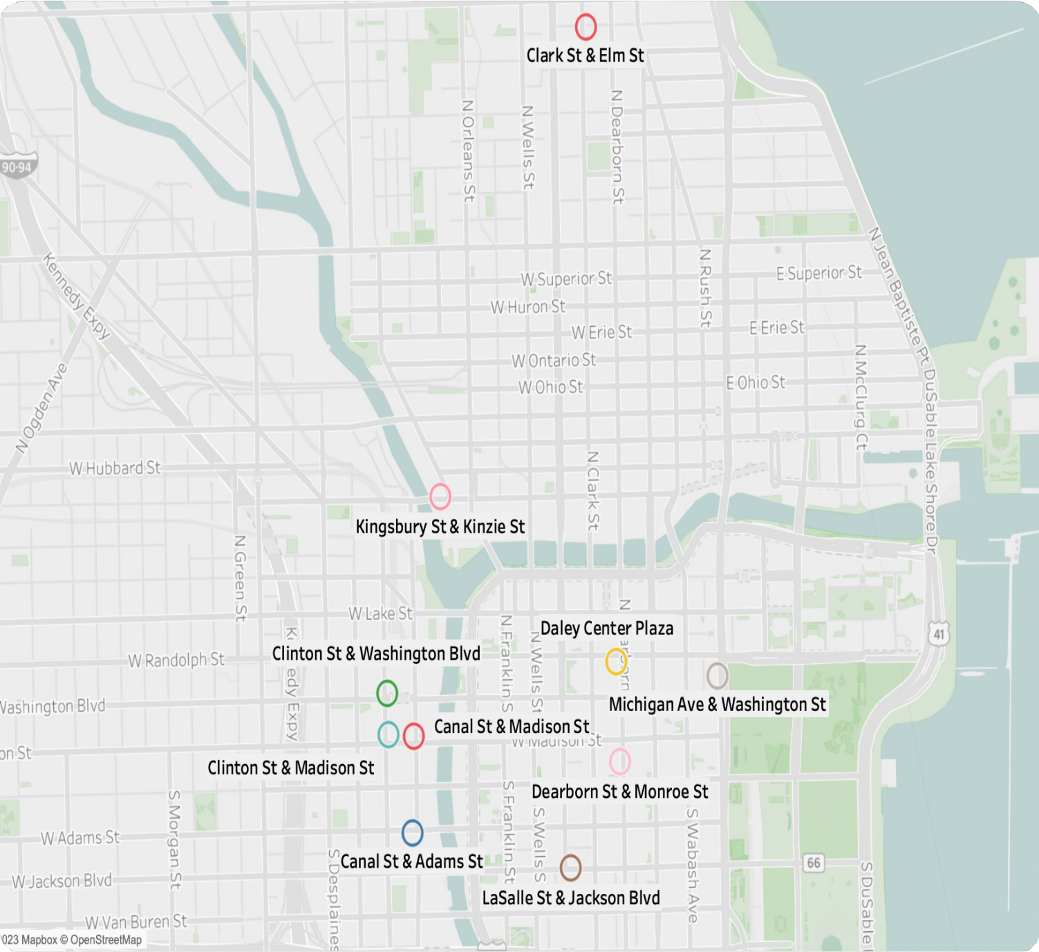

POPULAR DEPARTURE STATION
POPULAR ARRIVAL

Slide 21
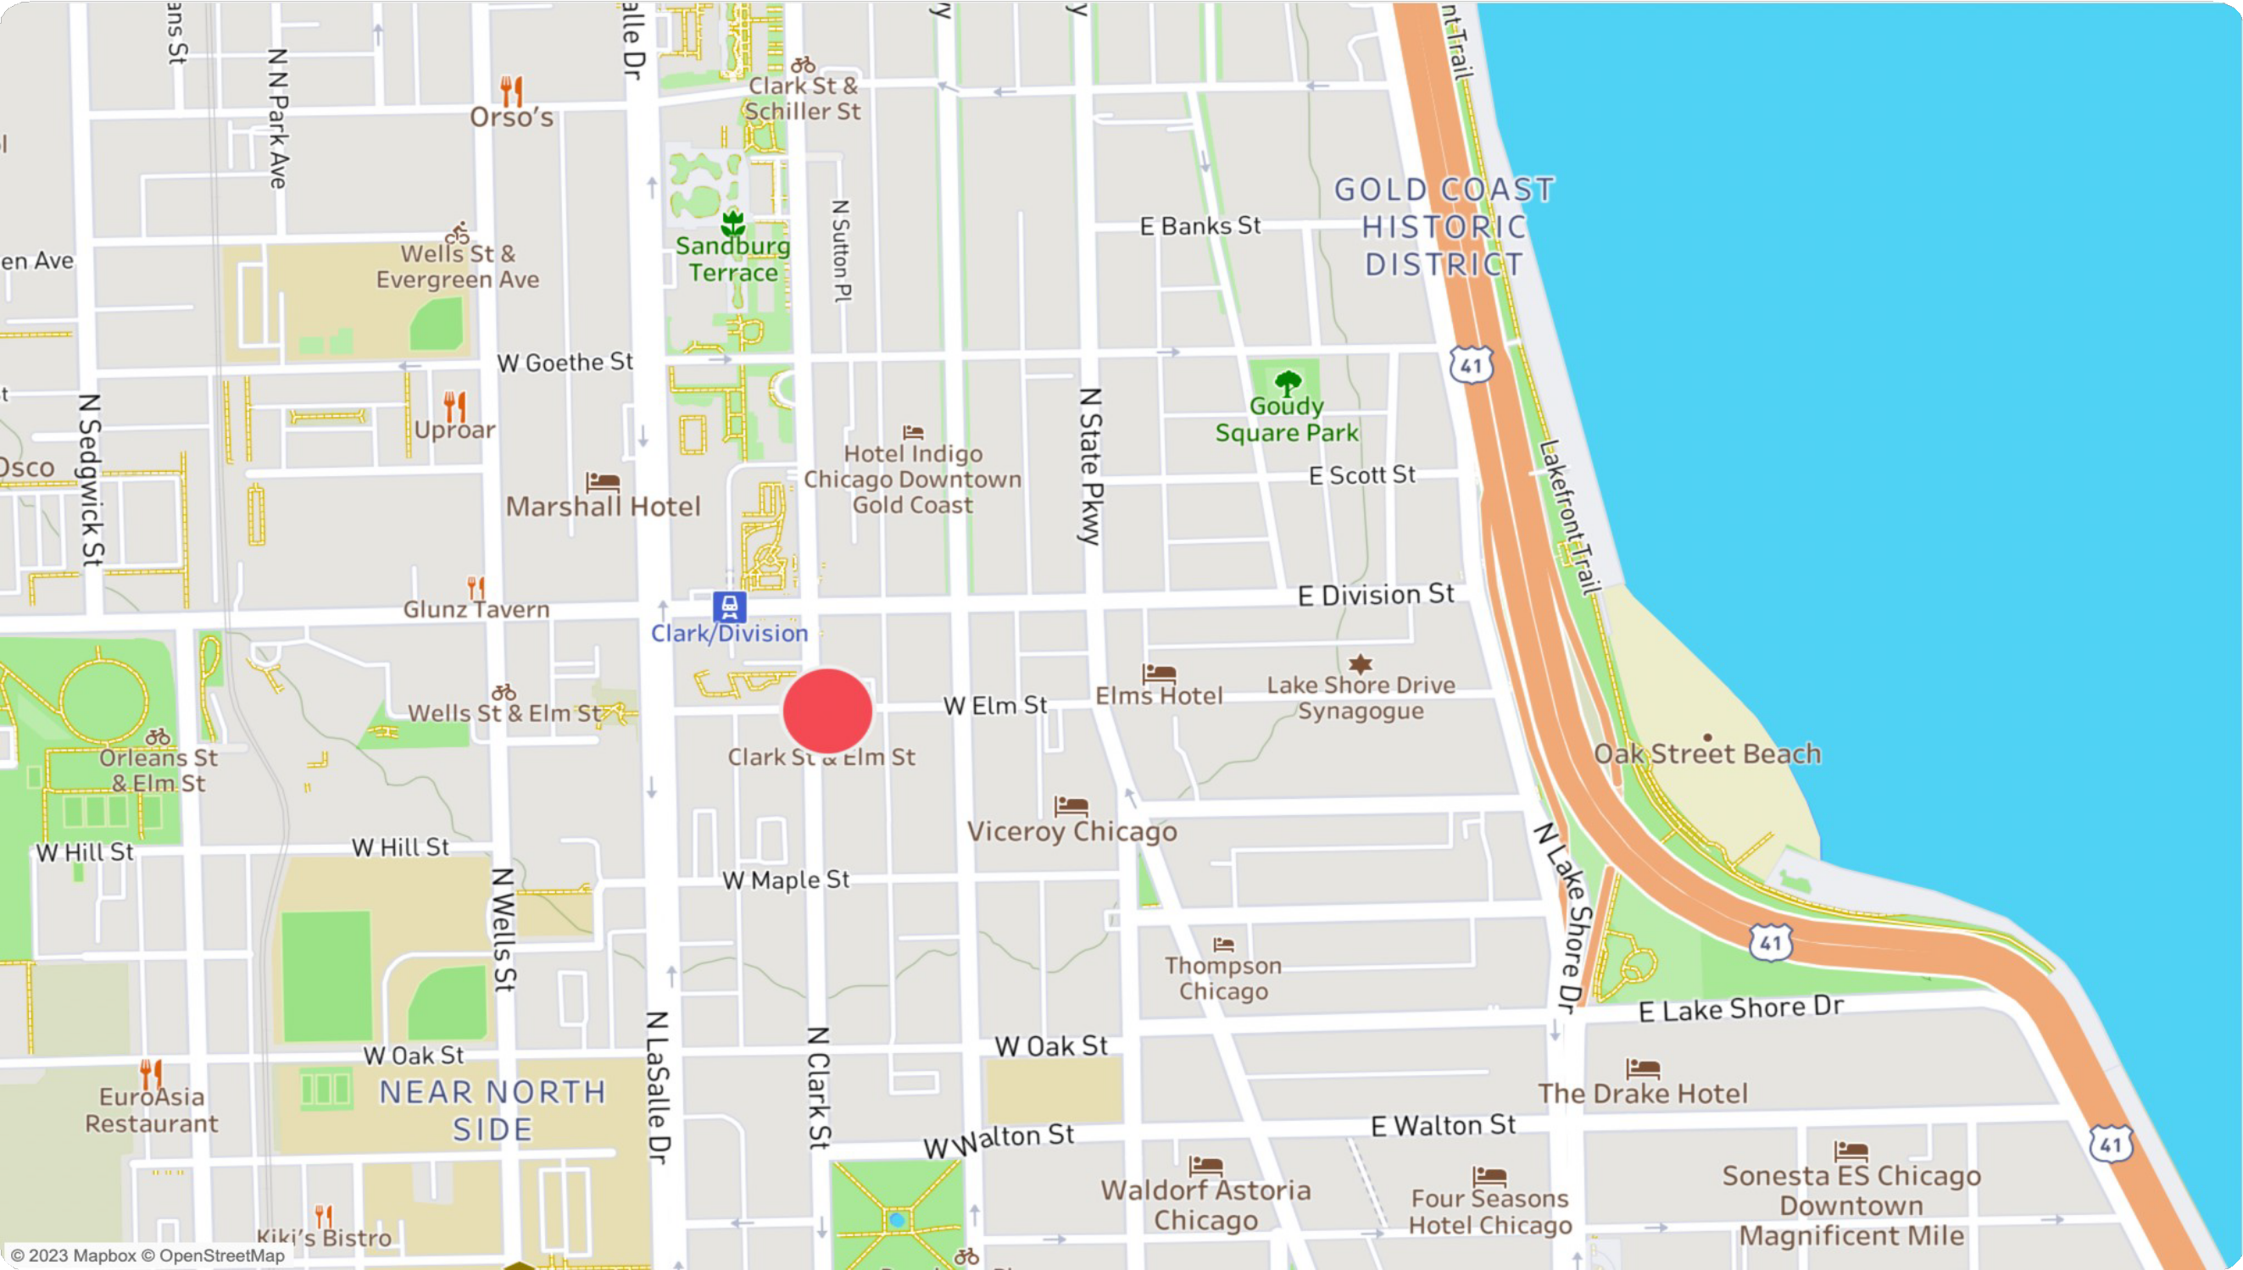
WHY IS IT POPULAR?
POPULAR DEPARTURE STATION

Slide 22


SAFETY
“Safety was by far the leading concern for all riders — 79% of the women cited”

Slide 23

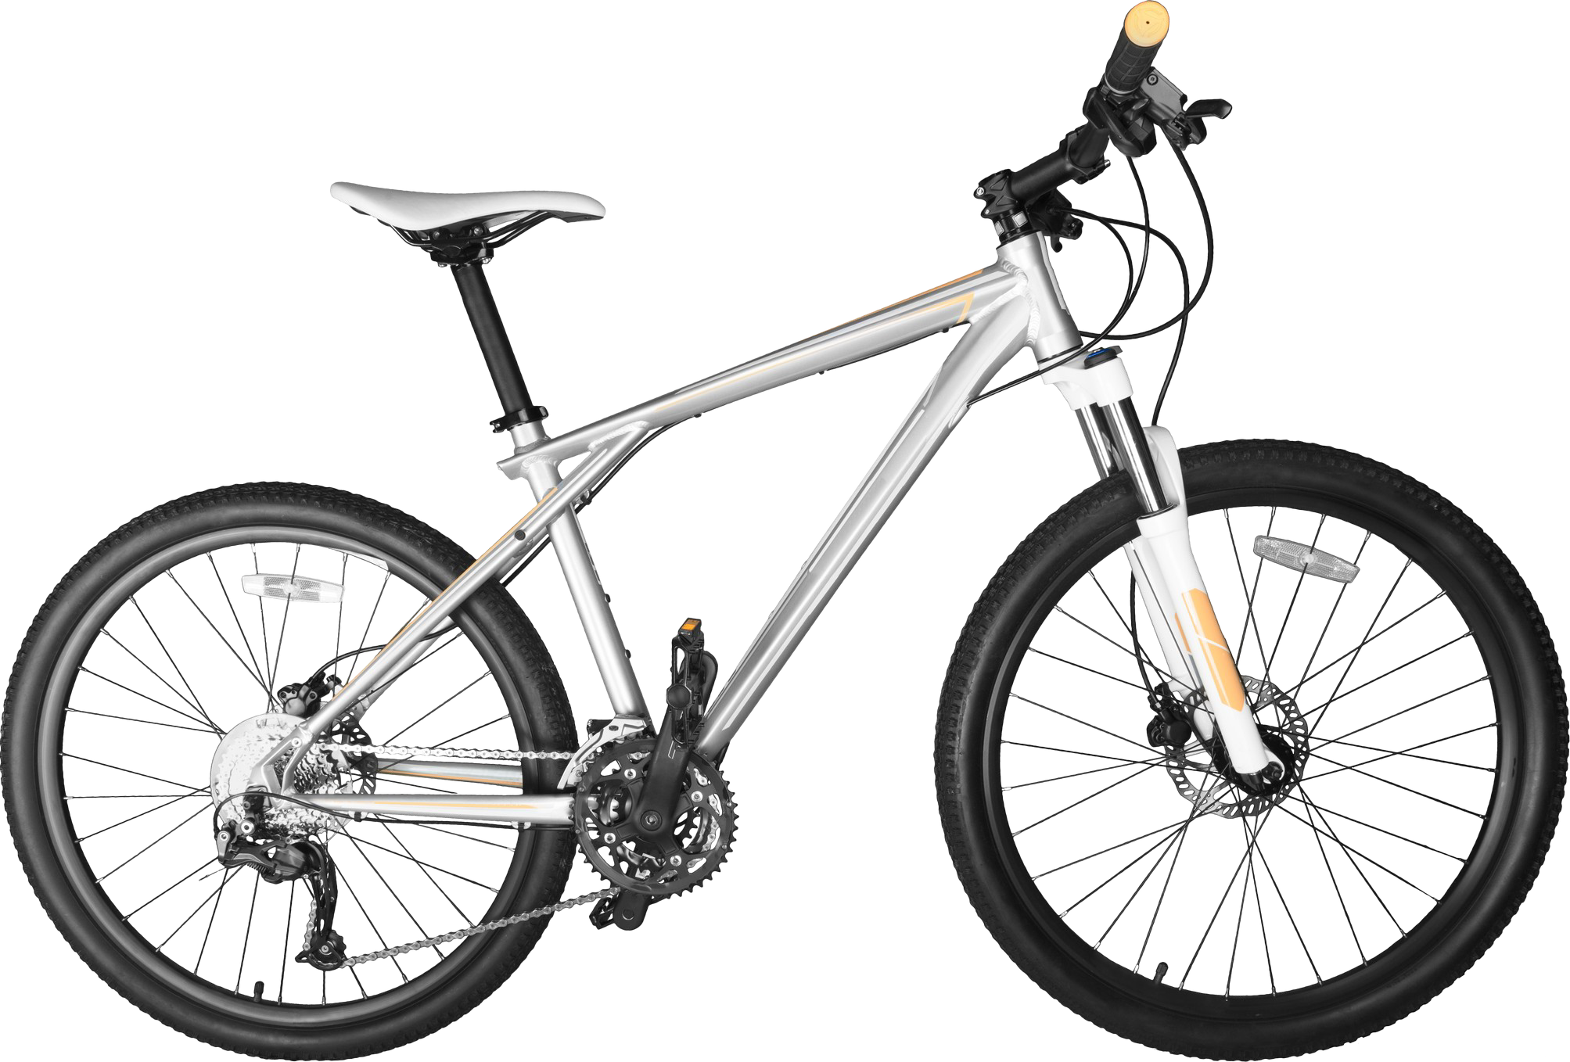
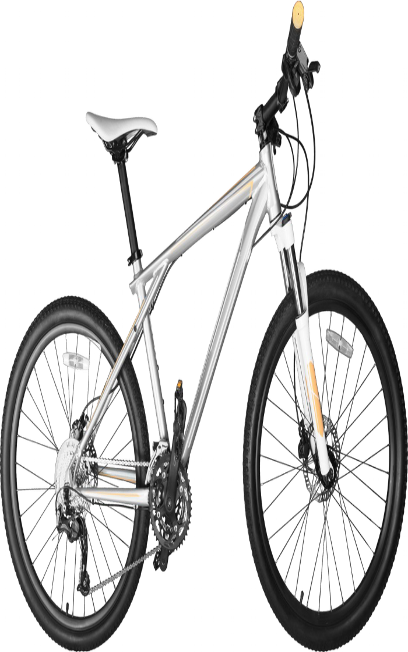
MOBILE FEATURE
S
RECOMMENDATIO
N• 1
57% of users feel safer when their locations are tracked by apps
15% don’t feel safe and don’t want to be tracked.

Slide 24

“YOU ARE SAFE WITH DIVVY”
ADDING A
Make companies 6% more memorable
Can have a 23% increase in revenue
75% of consumers judge a brand's credibility based on its slogan and logo
SLOGAN
RECOMMENDATIO
N 2

Slide 25

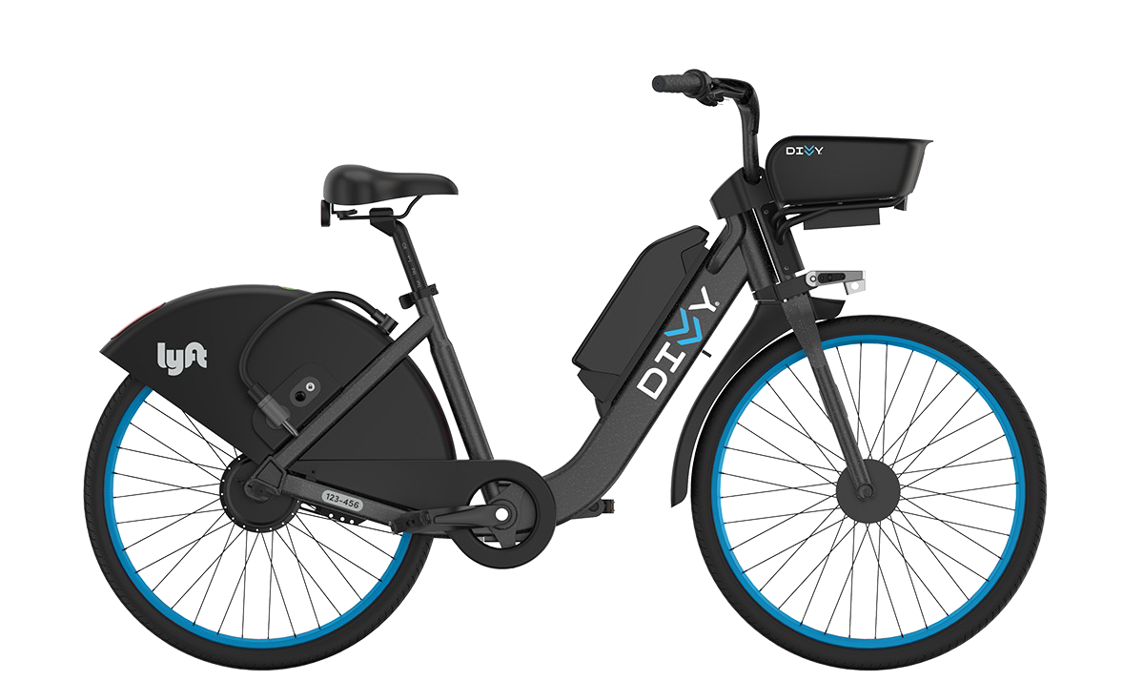
A MORE COMFORTABLE
R^{D}ECEOM^{S}ME^{I}N^{G}DA^{N}TIO N 3
Address issues with size and weight
Offer more inclusive bike sizes at popular locations

Slide 26
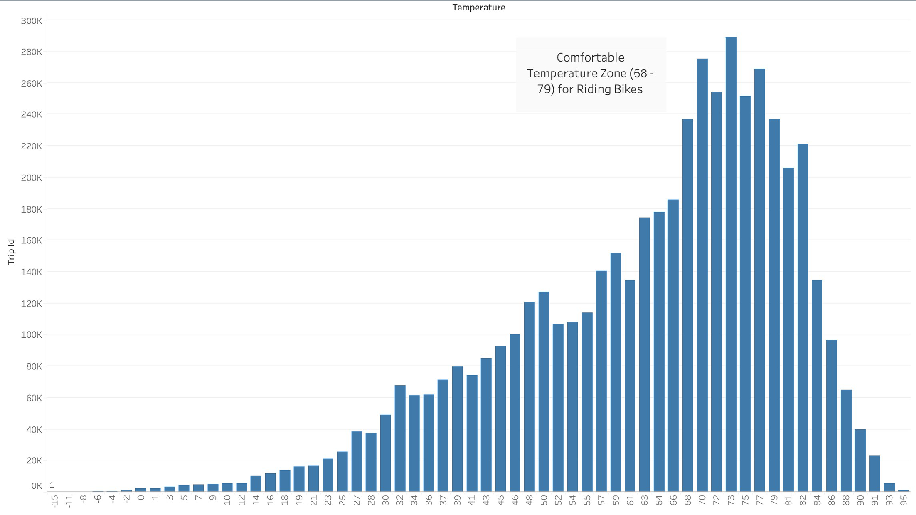

Slide 27

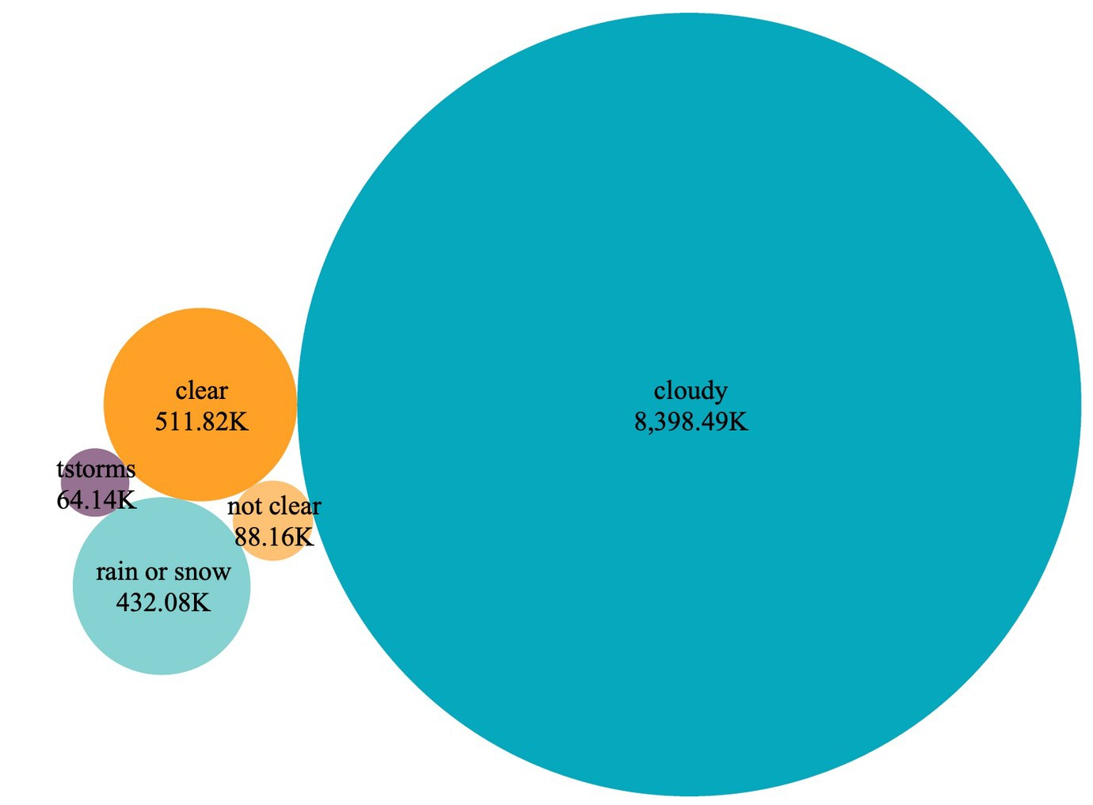
SEASONALI TY ANALYSIS
^{B}CO^{Y}NDITIONS & TOTAL
_{W}RIDE_{E}RS_{A}HIP_{THER}

Slide 28

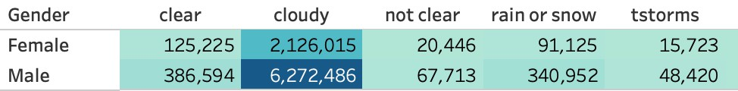
TOTAL RIDERSHIP OF GENDER FOR WEATHER CONDITIONS

Slide 29
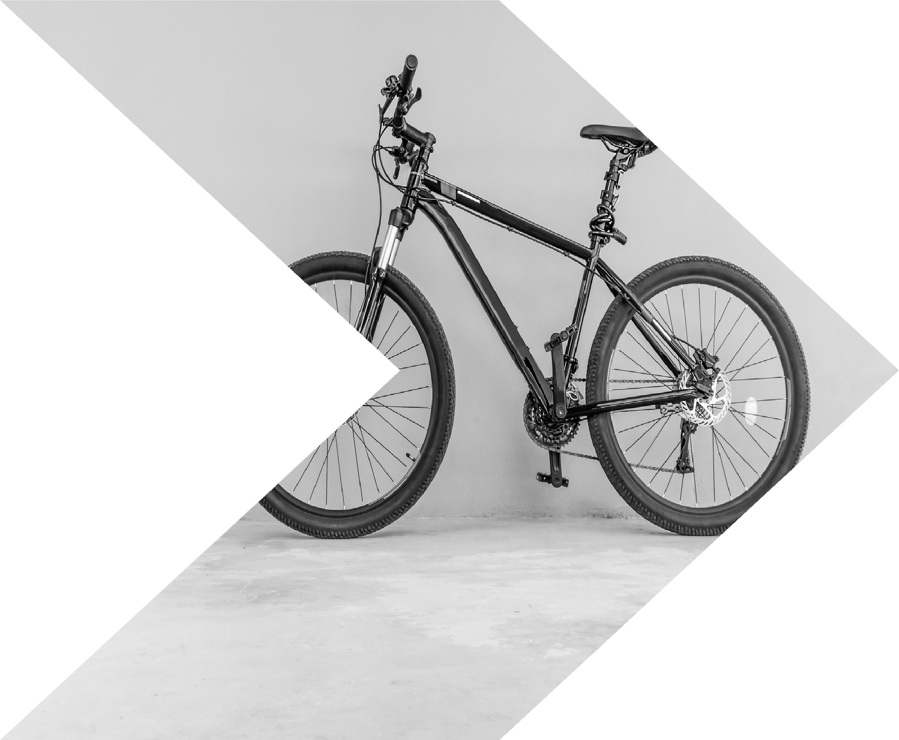

RECOMMENDAT IONS
Offer family discount (15%) during the summertime
Update the Divvy app to alert riders of potential weather hazards, partnership with The Weather Channel.

Slide 30
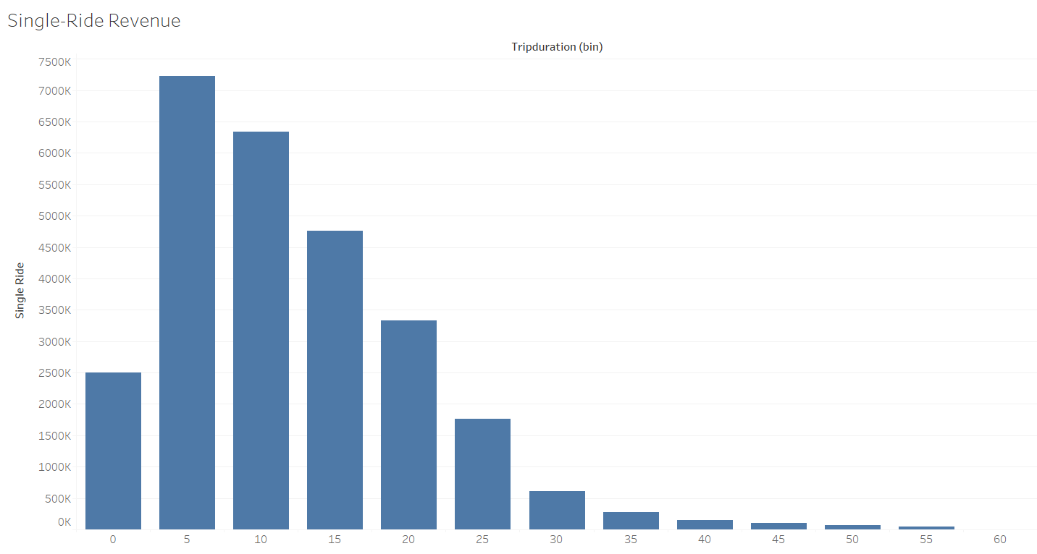
$7,221,670
Total:
$27,181,709

Slide 31
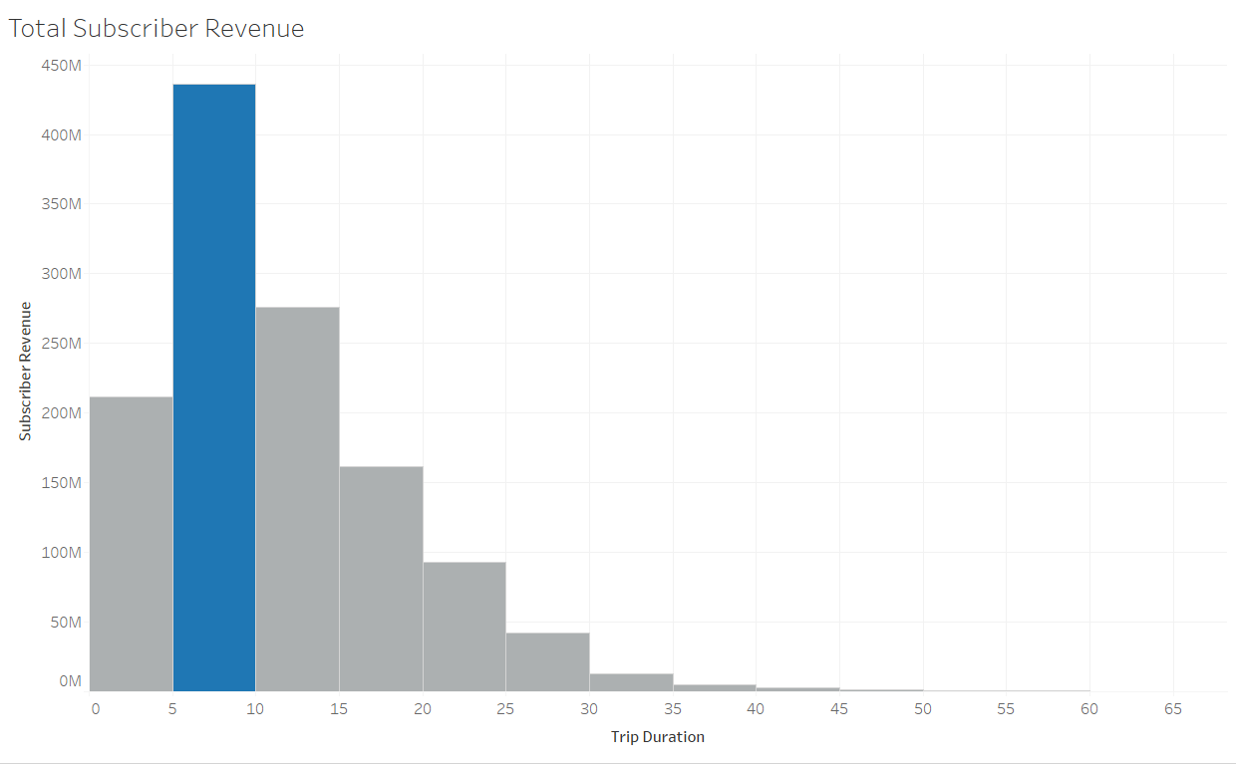
Extra Charge of $0.17/ min begins here
$435,796,47 9

Slide 32
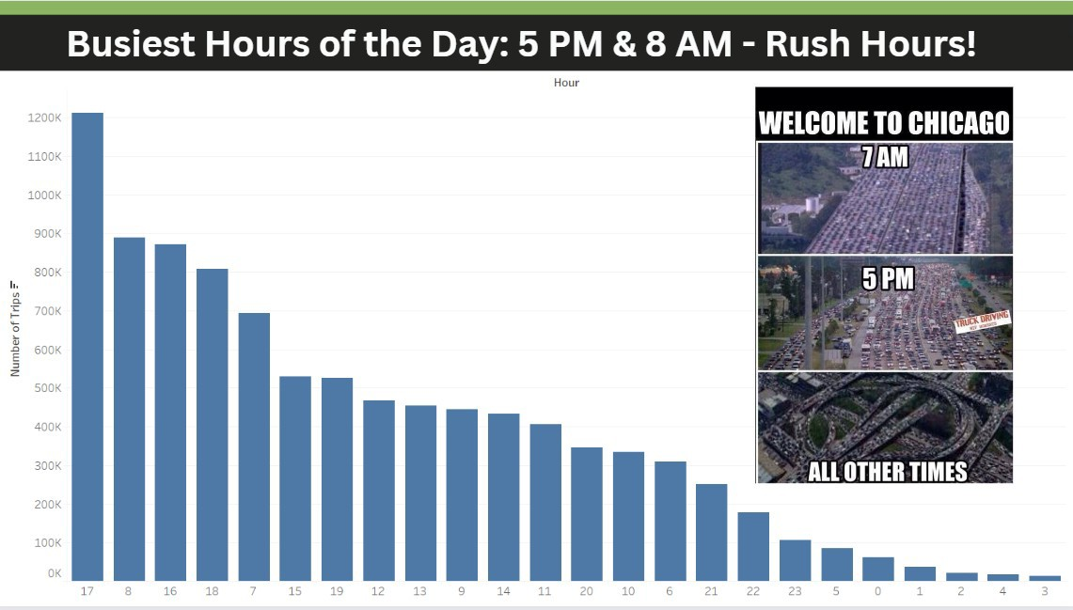

Slide 33
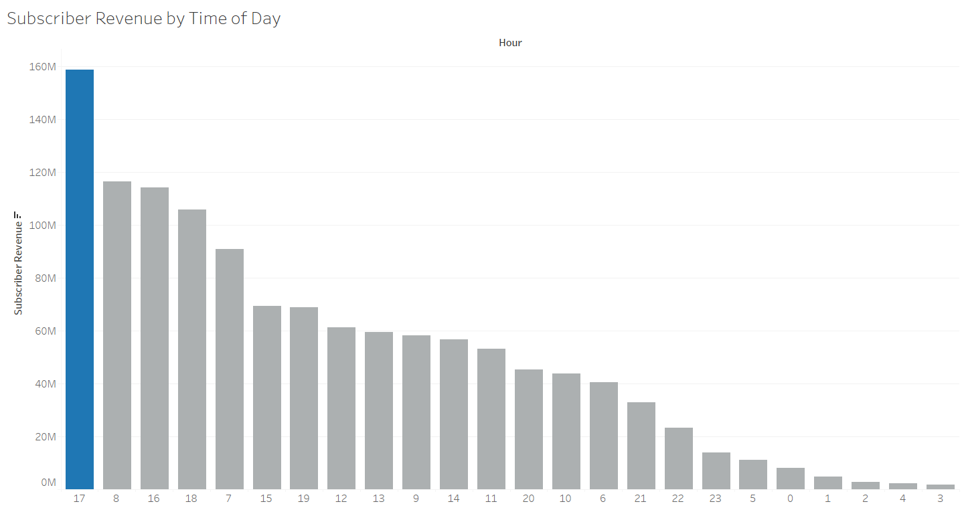
$158,562,17
4
Total Revenue:
$1,242,757,421

Slide 34
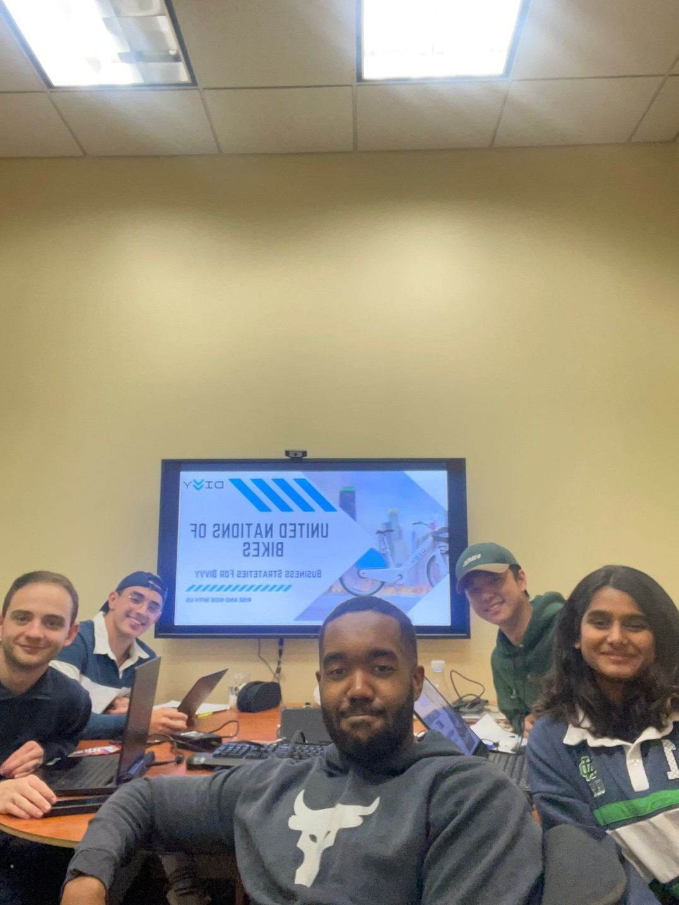

THANK YOU

